Slide 1



Buildable DIGITAL HEALTH BLUEPRINT
A workshop to model the health-related “value capture” from a national-scale digital health infrastructure investment.
Digital Health Investment Rationale
[Date].
Dollars
DALYs

Slide 2
WORKSHOP PLAN
This deck is designed to support a full-day Investment Rationale Workshop. The agenda is designed so that a country partner can conduct this 1-day workshop instead of leveraging the full set of four Toolkit workshops.
The premise of this workshop is that attendees will, in real time, discuss and inform the filling in of an Investment Rationale spreadsheet to model the economic value captured by a national-scale digital health infrastructure implementation (including an HIE). This is identified as a Q4 activity.
The preceding workshop quarters (Q1-Q3) supported by the sections in this deck cover important metaphors and conceptual frameworks that would have otherwise been covered by the Toolkit workshops. They also are intended to contextualize the investment rationale to the target country’s as-is situation.
Any section that the facilitator believes is not needed may be omitted.
Example slides from Botswana are included as an illustrative example.

Slide 3

WORKSHOP AGENDA
<example agenda… edit as necessary>
Q1 – Official start & brief introductions / Overview of Present State [9-10:30am]
IHME Burden of Disease (BOD); Digital Health Monitor report; Published Health and Digital Health Strategies; Digital health implementations to date
Q2 – Archetypal “OpenHIE-on-FHIR” Blueprint [11am-12pm]
Architectural elements; Conformance-testable digital health “Lego® blocks”; Normative Point-of-Service (POS) system behaviours
Lunch [12-1pm]
Q3 – Mapping from Present State to Future State [1-2:30pm]
Existing Infrastructural Elements and “Gaps”; Key Infrastructure Design Choices; Implementation Science Approaches
Q4 – Developing an Investment Rationale in real time [3-5pm]
Filling in the remaining tabs on the Investment Rationale tool; Sensitivity analysis; Discussion; Meeting close and next steps

Slide 4


TEAM
<example country flag-map… edit as necessary>
<leverage this slide as a placeholder to officially start the workshop and introduce stakeholders>

Slide 5

WHERE ARE WE NOW?
Burden of disease (IHME)
Digital readiness (GDHM)
Strategic goals
Health system strategy
Digital health strategy
Digital health implementation progress

Slide 6
WORKSHOP AGENDA
<example agenda… edit as necessary>
Q1 – Official start & brief introductions / Overview of Present State [9-10:30am]
IHME Burden of Disease (BOD); Digital Health Monitor report; Published Health and Digital Health Strategies; Digital health implementations to date
Q2 – Archetypal “OpenHIE-on-FHIR” Blueprint [11am-12pm]
Architectural elements; Conformance-testable digital health “Lego® blocks”; Normative Point-of-Service (POS) system behaviours
Lunch [12-1pm]
Q3 – Mapping from Present State to Future State [1-2:30pm]
Existing Infrastructural Elements and “Gaps”; Key Infrastructure Design Choices; Implementation Science Approaches
Q4 – Developing an Investment Rationale in real time [3-5pm]
Filling in the remaining tabs on the Investment Rationale tool; Sensitivity analysis; Discussion; Meeting close and next steps

Slide 7


Our process for Q4 will be to decide upon and fill in the content that “drives” the digital health Investment Rationale for Botswana… and then to do some simple sensitivity analysis.
Enter activity-based budget drivers
Decide on burden of disease targets
Establish notional project timelines
Run a few simple what-if scenarios

Slide 8
IMPLEMENTATION COST & TIME DRIVERS
HIE infrastructure costs will tend to have an installation/one-time fee plus an operating fee. This will be typical for the cloud-hosted HIE services and for façades and integrations to legacy solutions.
Adoption costs will be driven by the number of:
Clients – health ID “credential” to be issued at first care visit, and regularly refreshed
Facilities – attributes collected and regularly refreshed; POS solutions implemented and operated
Care providers – attributes collected and regularly refreshed
Terminology updates – code lists published, and POS solutions updated
Indicator report submissions.
Costs will accrue immediately, but benefits will not accrue until “critical mass” is reached – this is an incentive to implement quickly.
Inflation, if it is high, adds a further incentive to go quickly
Ongoing governance and management costs must be accounted for.

Slide 9

CAUTION: If we try to determine the one precise and “correct” value for every element of the model, we will drive ourselves crazy and waste our time.

Slide 10

The key is to agree on values that are “close enough”.
Over any 10-year period, it is impossible to be precise.
Close enough is perfect!
All models are wrong.
Some models are useful.

Slide 11


Slide 12

Meeting close and next steps…

Slide 13
WORKSHOP AGENDA
Q1 – Official start & brief introductions / Overview of Present State [9-10:30am]
IHME Burden of Disease (BOD); Digital Health Monitor report; Published Health and Digital Health Strategies; Digital health implementations to date
Q2 – Archetypal “OpenHIE-on-FHIR” Blueprint [11am-12pm]
Architectural elements; Conformance-testable digital health “Lego® blocks”; Normative Point-of-Service (POS) system behaviours
Lunch [12-1pm]
Q3 – Mapping from Present State to Future State [1-2:30pm]
Existing Infrastructural Elements and “Gaps”; Key Infrastructure Design Choices; Implementation Science Approaches
Q4 – Developing an Investment Rationale in real time [3-5pm]
Filling in the remaining tabs on the Investment Rationale tool; Sensitivity analysis; Discussion; Meeting close and next steps

Slide 14

How can we leverage digital health to improve health?

Slide 15
Health Interventions
Population
Health
Yield

Slide 16
Operationalizes
Health Interventions
Digital Health Infrastructure
Population
Health
Yield

Slide 17
Operationalizes
Health Interventions
Digital Health Infrastructure
Population
Health
Person-centric
transactional data
Generate
Yield

Slide 18

Operationalizes
Population-level
health metrics
Health Interventions
Digital Health Infrastructure
Population
Health
Person-centric
transactional data
Generate
Yield

Slide 19

Operationalizes
Inform
Population-level
health metrics
Health Interventions
Digital Health Infrastructure
Population
Health
Person-centric
transactional data
Generate
Yield

Slide 20
The “key” impact from digital health is that it can help us maximize the care delivered in the GREEN ZONE.
Errors of
Omission
Everything that was done during a care encounter
The GREEN ZONE
Everything that should be done during a care encounter
Errors of Commission

Slide 21

KEY TAKEAWAY POINTS
We can use digital health to both meter the health system – and to exert process control upon it.
Digital health can play an industrial engineering role. It can be leveraged to improve consistency in execution of the “health production function”.
We should leverage digital health in support of care workflows. Atomic, person-centric data serves both person-centric care and population-level monitoring.
Analytics can be leveraged to inform improvements to the health system operations, and/or to the digital health supported interventions. This feedback loop creates a Learning Health System.

Slide 22

Based on IHME, what are our what are our health metrics, including our current burden of disease?
https://www.healthdata.org/research-analysis/health-by-location/profiles/botswana
<example IHME link… edit as necessary>

Slide 23
IHME CONTENT…
Navigate to the IHME country site (e.g. for Botswana, https://www.healthdata.org/research-analysis/health-by-location/profiles/botswana )
Copy IHME health metric graphics into the deck, one per page, and insert a comment to note the relevant takeaway message from each metric. Examples for Botswana are shown.
Add a “key takeaways” slide at the end to summarize the relevant messages (Botswana example, included)

Slide 24
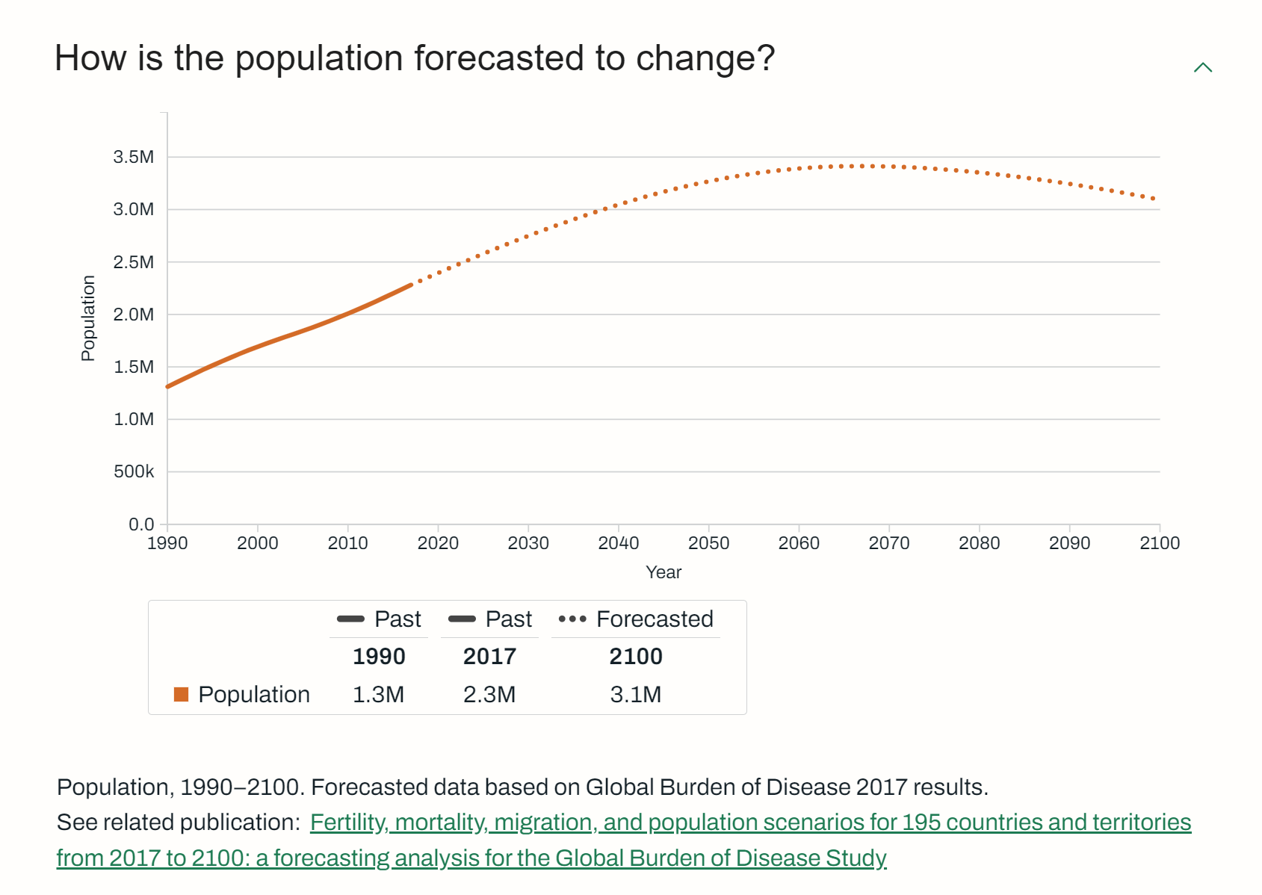
50% increase over coming 25 years.

Slide 25
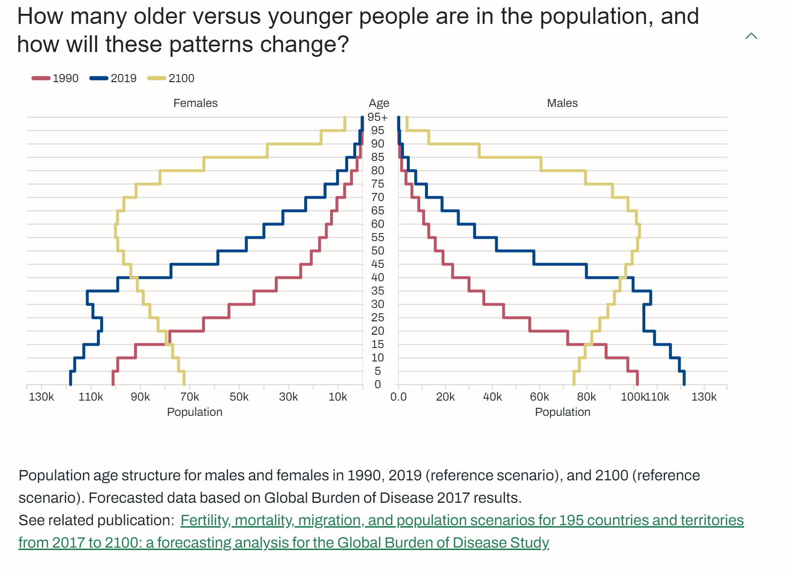
The “pyramid” becomes a water tower.

Slide 26
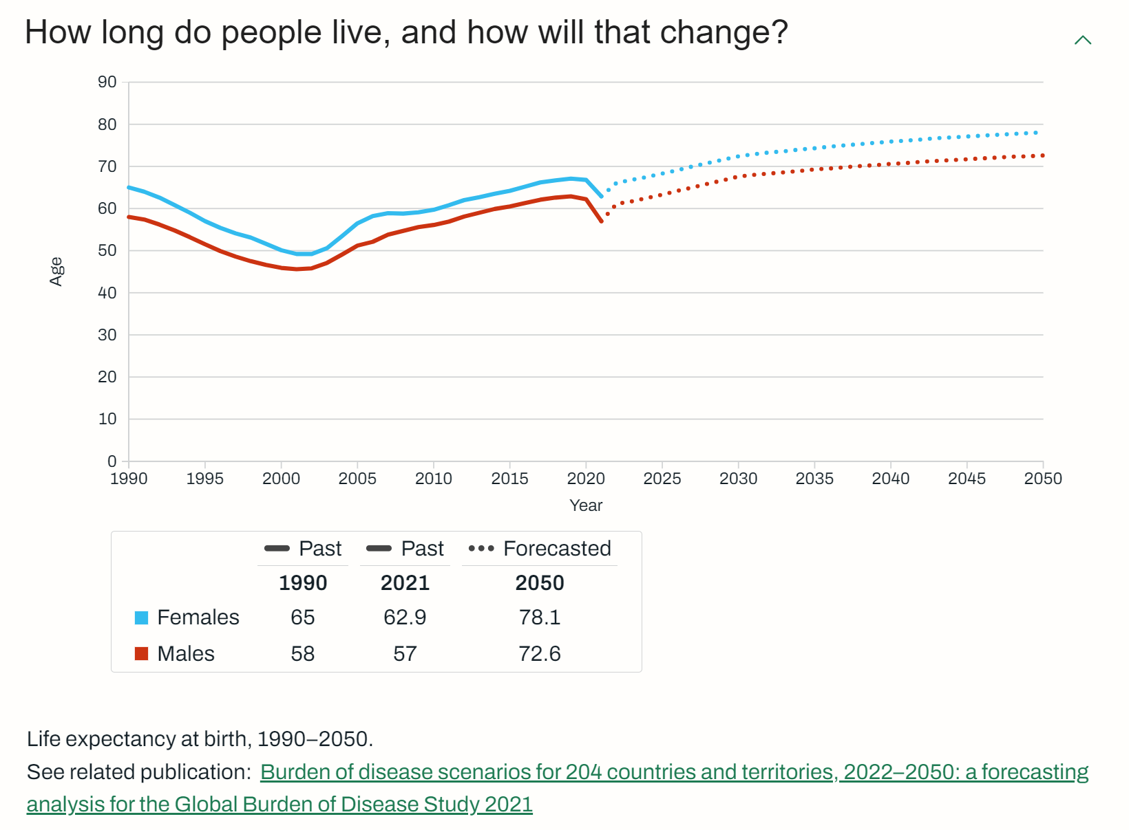
The “grey tsunami” will increase the NCD burden.

Slide 27
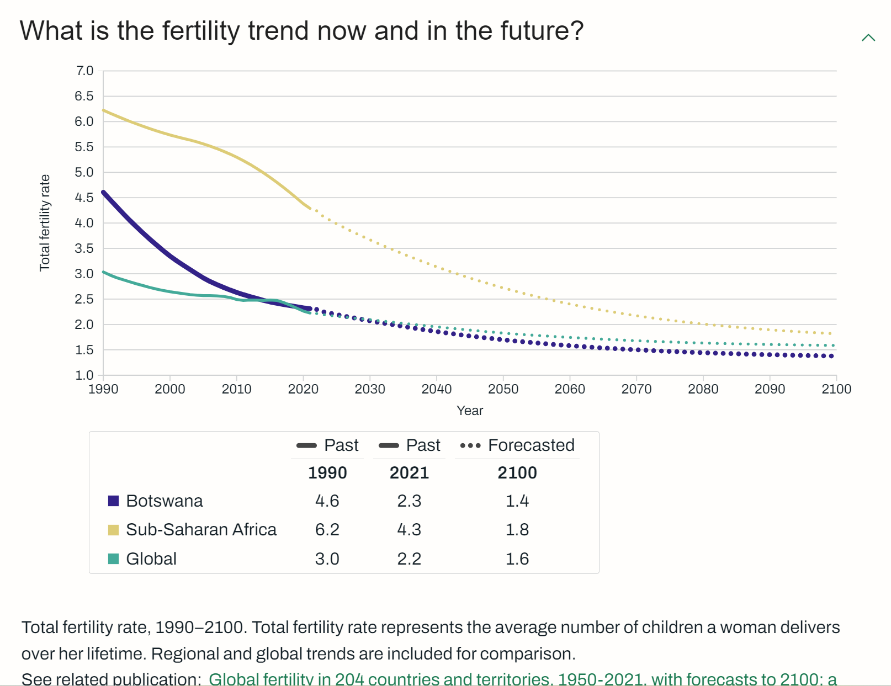
Our trend is “ahead” of the SSA curve.

Slide 28
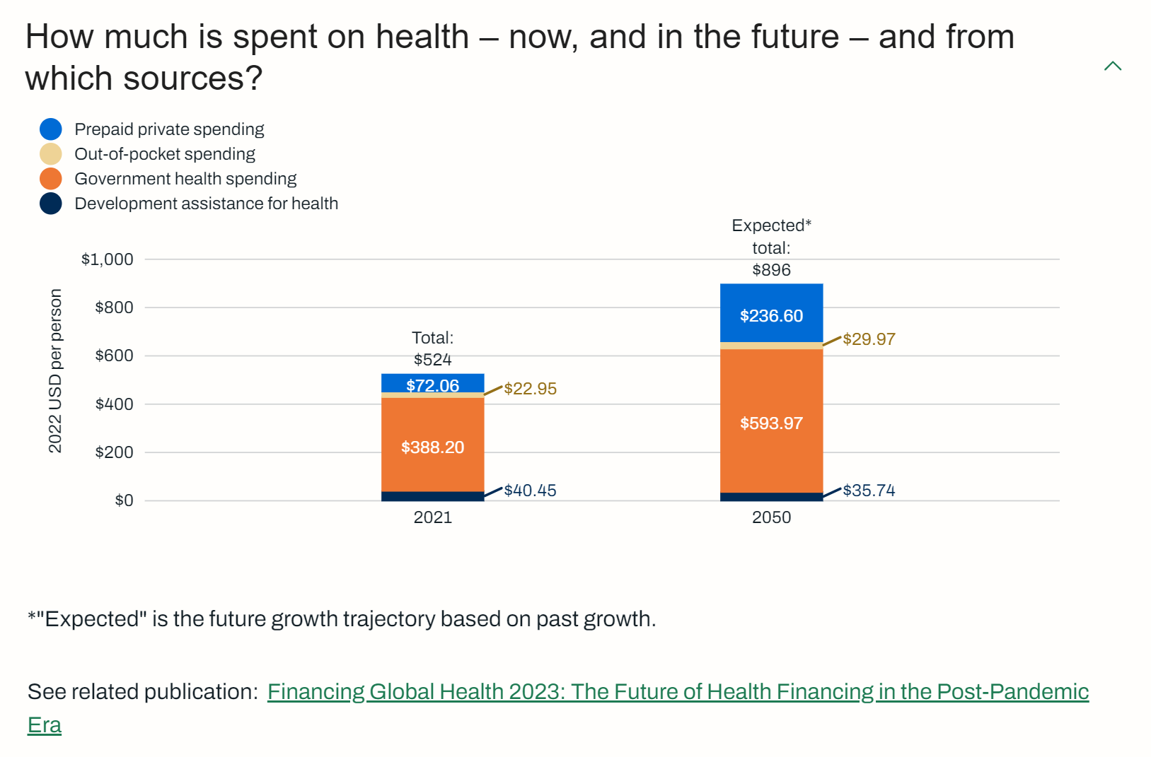
The proportion of private insurance will increase.

Slide 29
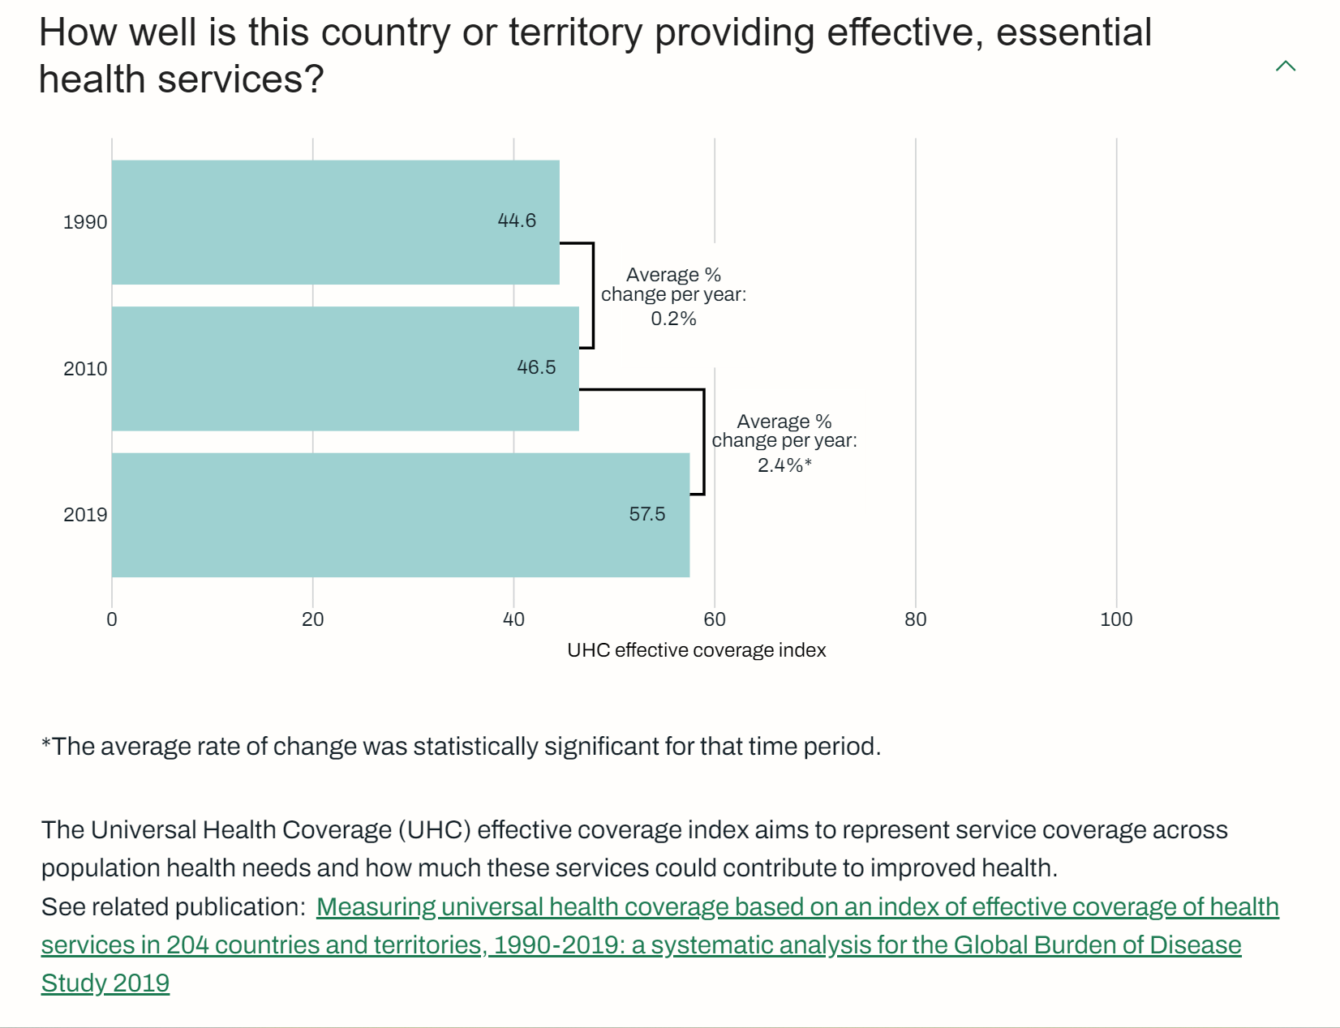
There is steady progress… and room to improve.

Slide 30
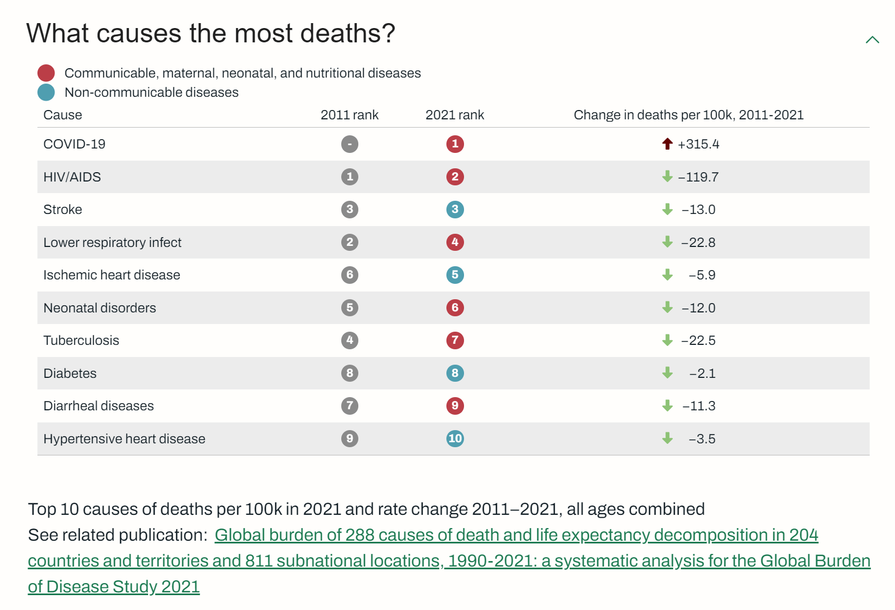
4 of 10 NCDs

Slide 31
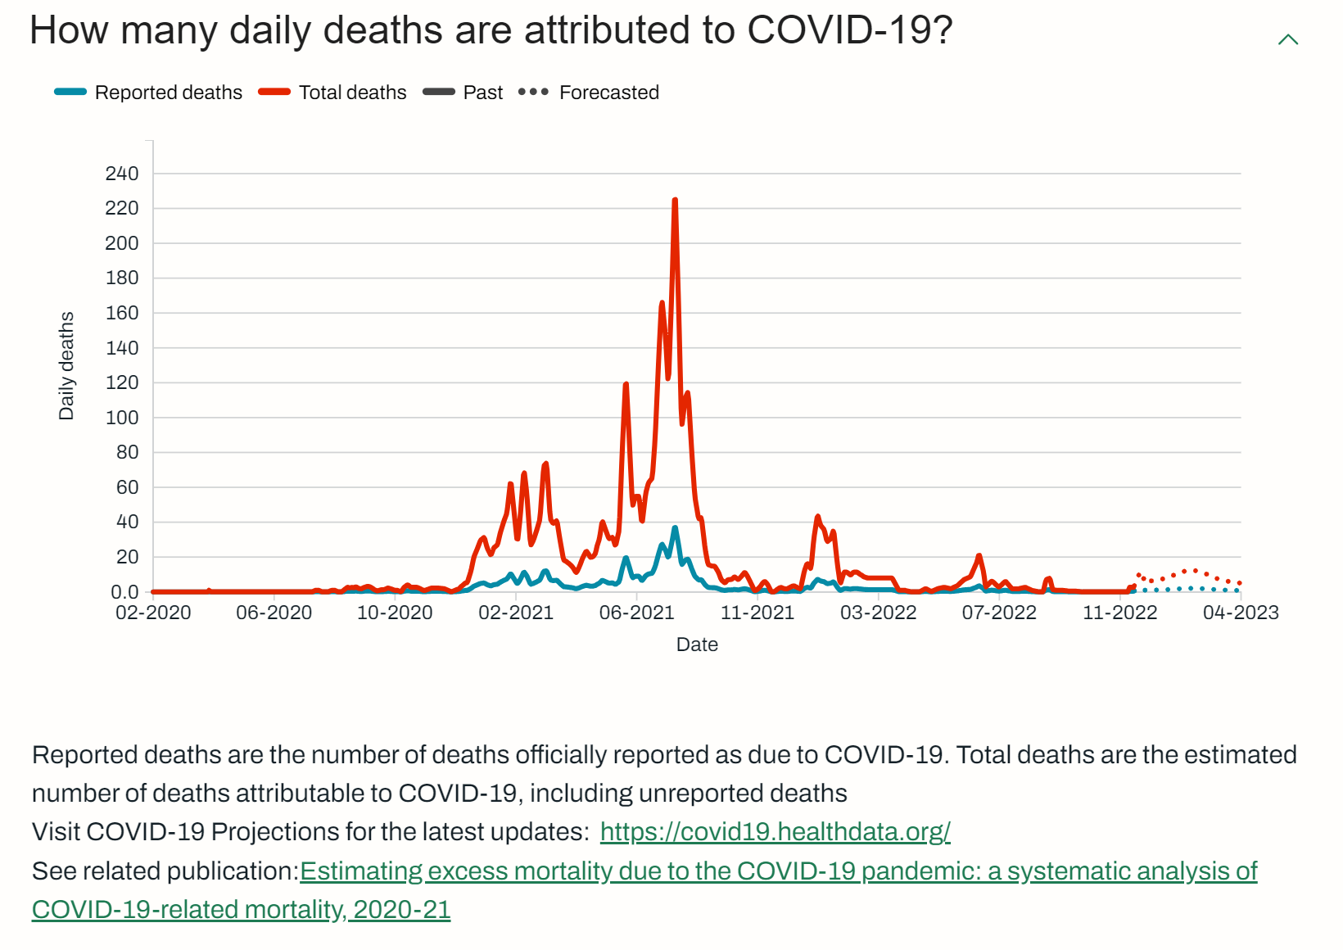
The actual rates outpaced the reported rates.

Slide 32
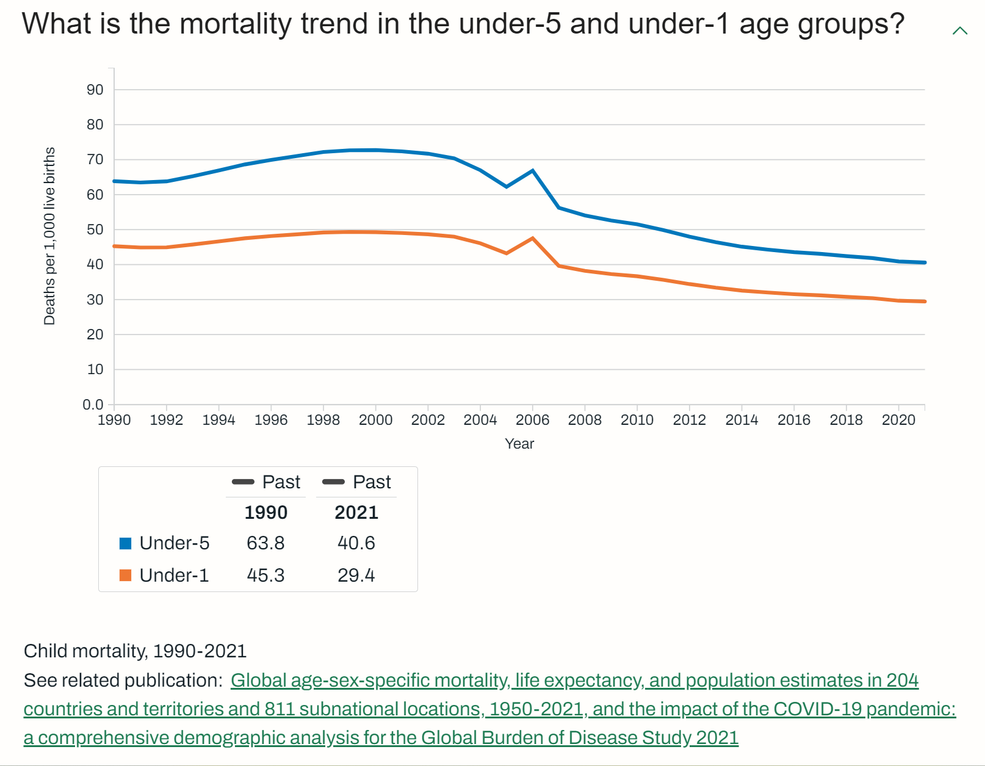
Steady, long-term progress, with room to improve.

Slide 33
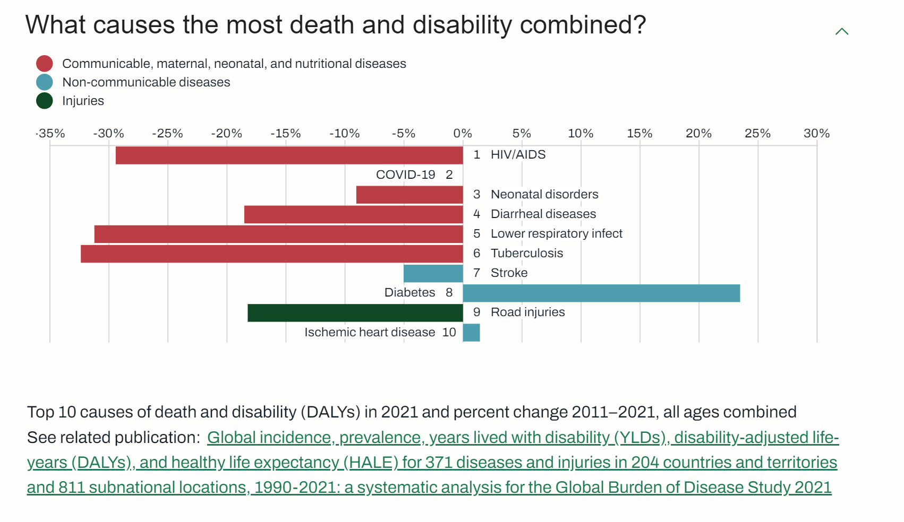
Great progress on reducing the overall burden.

Slide 34
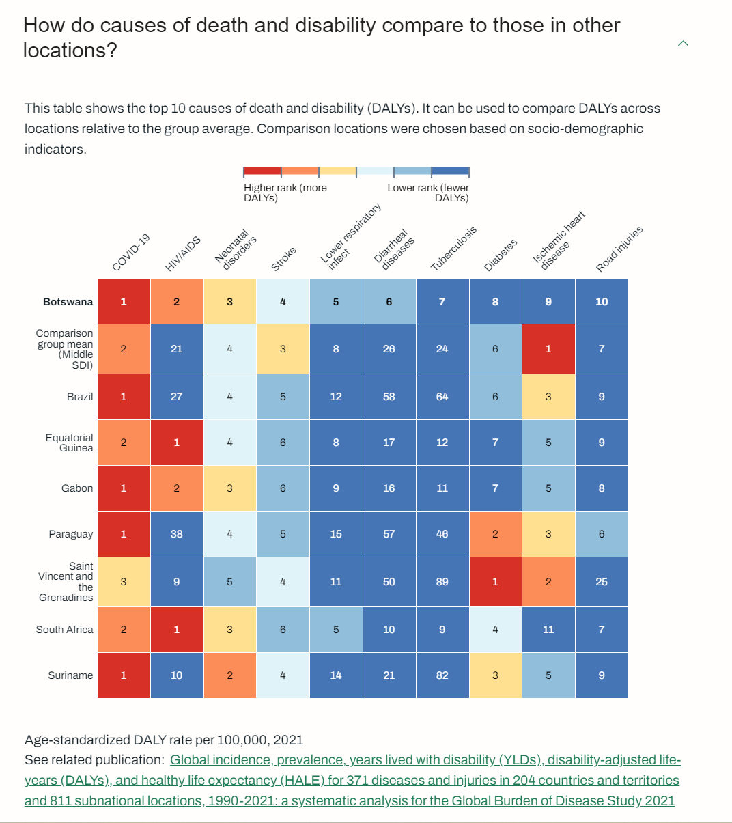
On NCDs we do well vs. peers. COVID hit us hard.

Slide 35
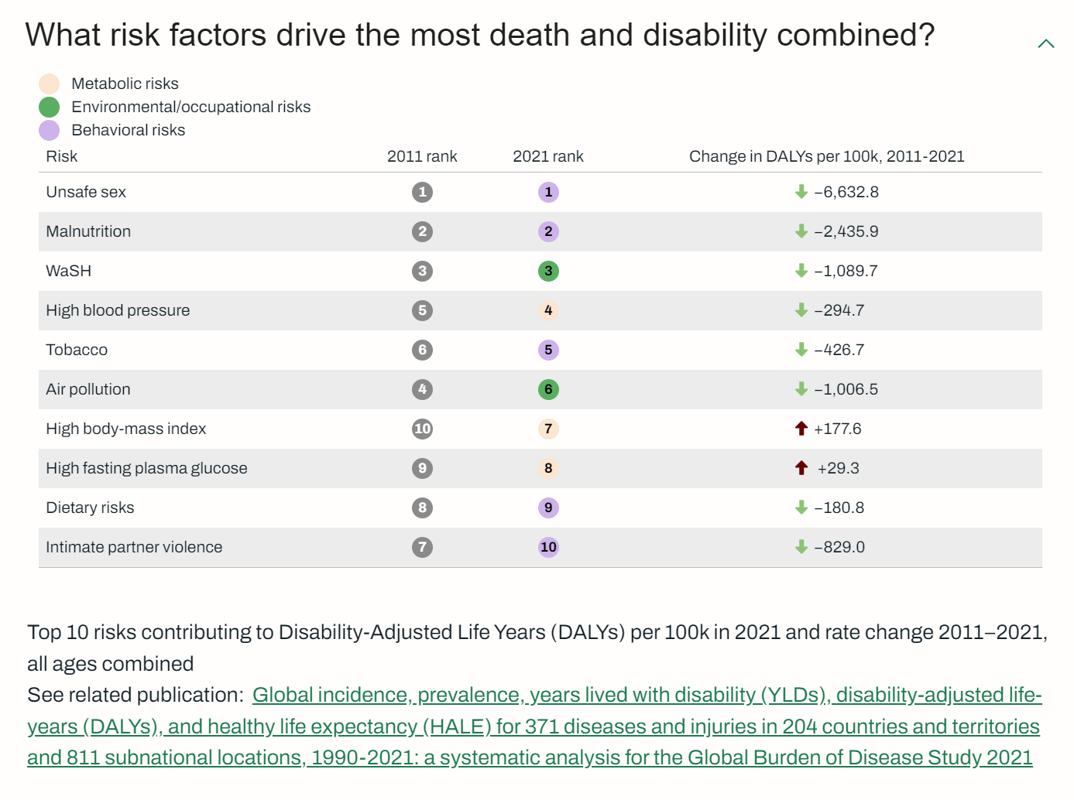
*
*
*
*
Many risks addressable through health interventions.
*

Slide 36
KEY TAKEAWAY POINTS
Botswana’s burden of disease is still dominated by communicable and neonatal diseases; these represent six of the top ten.
Significant progress has been made in addressing the overall burden. Excepting COVID, there are reductions across the “top-7”, with three reduced by ~30% between 2011-2021.
NCDs are a concern. Diabetes’ burden has increased 23% over the last decade.

Slide 37

What digital health architectural components are needed to execute the “health production function”?

Slide 38











To mitigate risk, the Toolkit leverages accepted international norms, standards, and conformance-testable architectural patterns. Data-informed decisions are based on credible global sources.

Slide 39
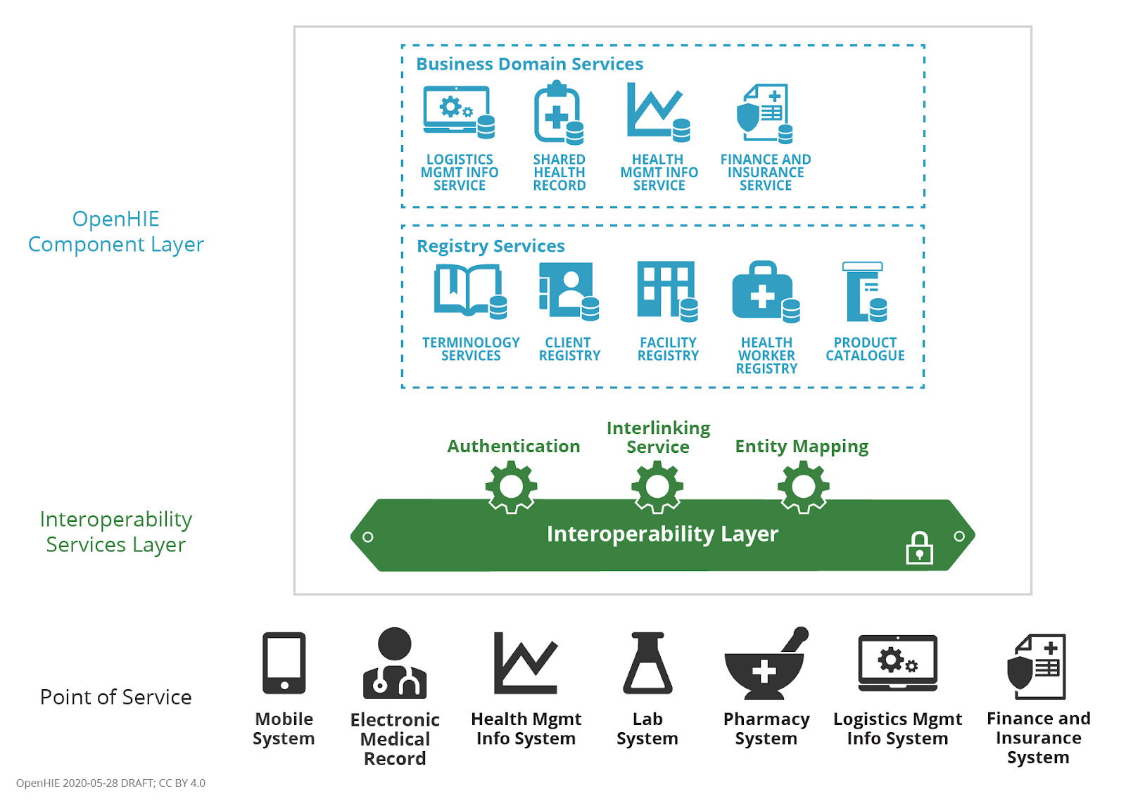

Over 60 LMICs have adopted OpenHIE as the basis of their health enterprise architecture. OpenHIE defines a set of infrastructure and service specifications that, together, operationalizes a health data sharing network.

Slide 40
For the purposes of our Buildable Blueprint specification, we will include
as in-scope the OpenHIE infrastructure and workflows directly related to healthcare delivery.

Slide 41

MHD
mADX
The OpenHIE community has identified IHE’s MHDS (mobile Health Data Sharing) portfolio of specifications as the transaction processing model for OpenHIE-on-FHIR.
SVCM
mCSD
PMIR
IUA
ATNA/CT
IHE MHDS
Transactional behaviour

Slide 42
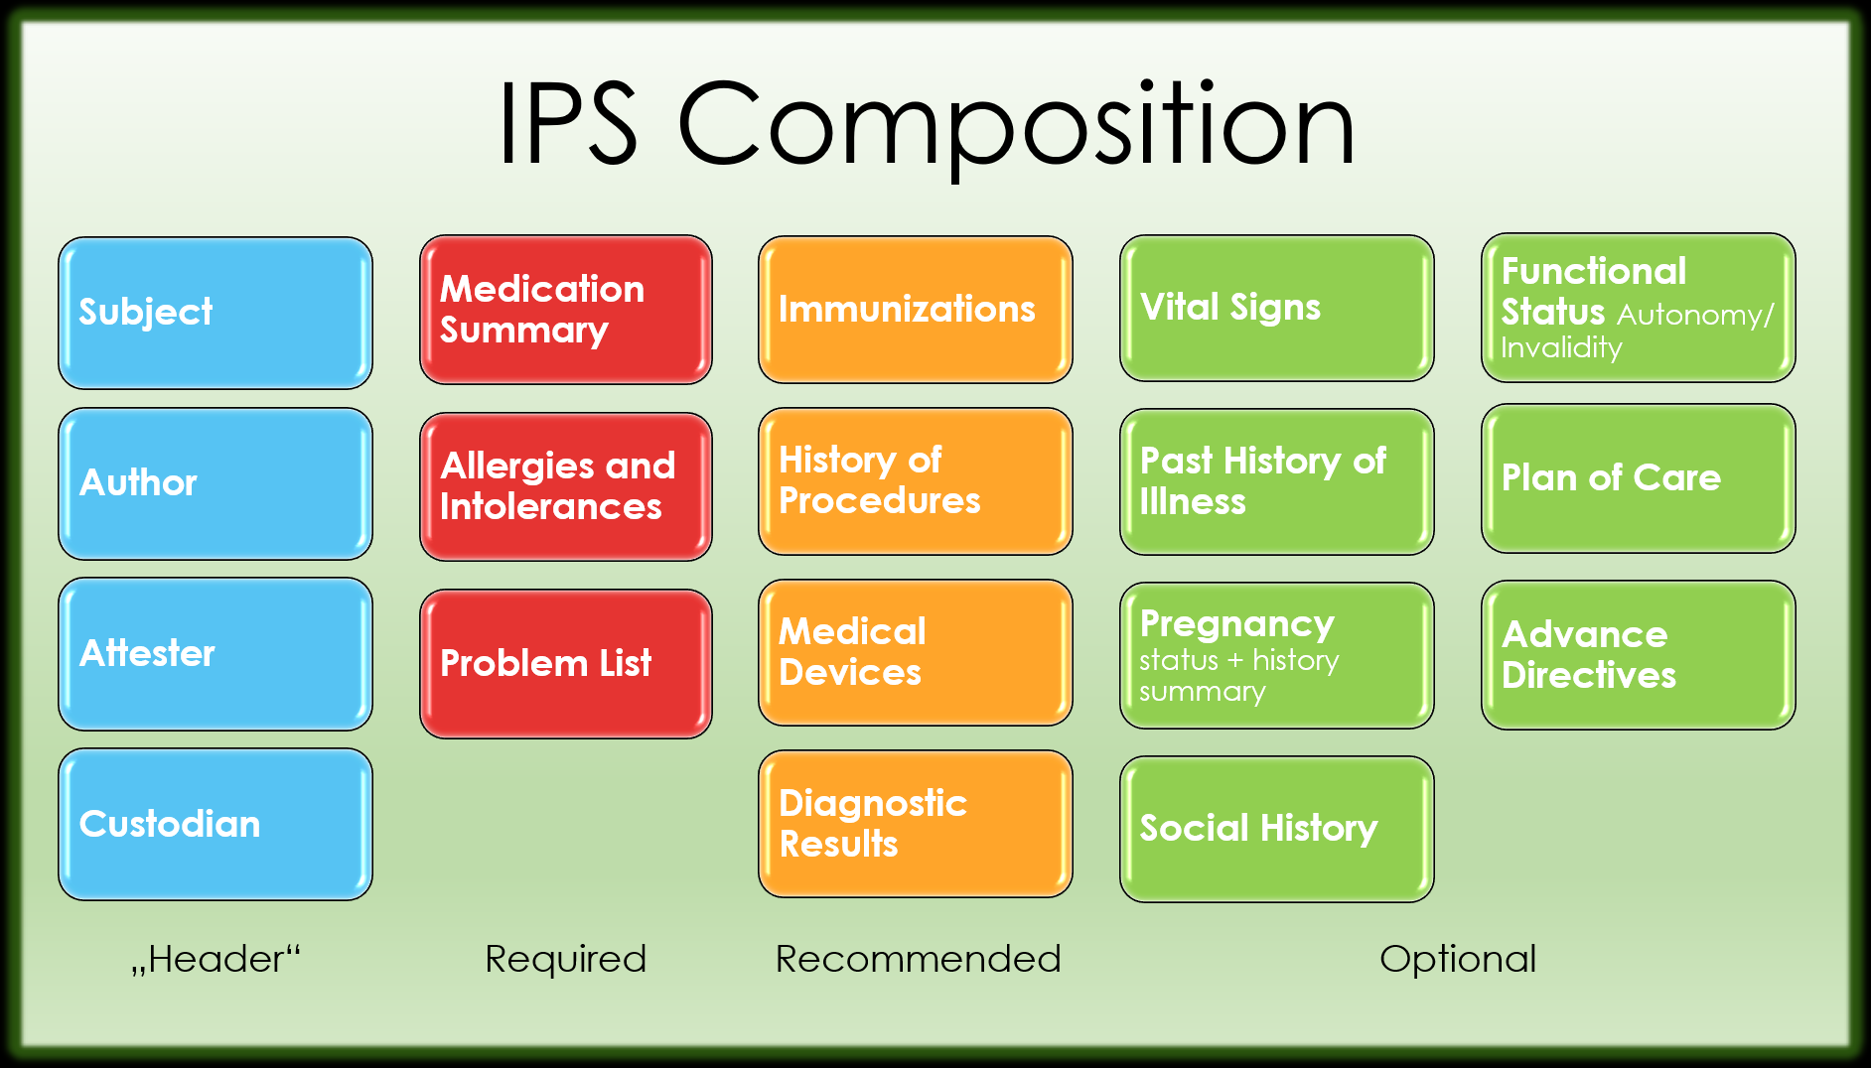



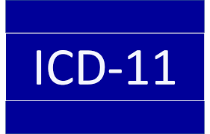


The OpenHIE community, the AeHIN network, and the GDHP have all selected the International Patient Summary (IPS) as their person-centric health data content model.
*
FHIR IPS IG
Content Model

Slide 43







Core transaction set
Add or update a patient demographic record
Query for a patient demographic record
Add or update person-centric health data
Query for person-centric health data
Query for registry content
Refresh registries from underlying (federated) directories
Submit aggregate data report
Lookup/validate codes and translate between codes
Retrieve and $apply computable care guideline (CCG)
Common functions related to security, privacy and auditing…
[ITI-93]
[ITI-78]
CR
[ITI-65]
[PCC-IPS]
[ITI-68]
[PCC-IPS]
SHR
[ITI-90]
[ITI-91]
ILR-HWR
ILR-FR
[QRPH-53]
[QRPH-58]
[ITI-98:ITI-101]
HMIS
[PCC-64]
[PCC-70]
ILR/TS
CCG Engine
ATNA
NOTE: at present – OpenHIE-on-FHIR is based on FHIR® v4.

Slide 44


HWD
FD
ORG
Interoperability Layer
OLTP FHIR Server
[ITI-91]
[ITI-91]
[ITI-91]
[ITI-91]
TS*
ILR/TS
ILR-HWR
ILR-FR
ILR-ORG
SHR
HMIS
CR*
CR
ATNA
[PCC-IPS]
[ITI-98:ITI-101]
There is a generic architectural pattern that drives the Investment Rationale.
[ITI-68]
[QRPH-58]
[ITI-65]
[QRPH-53]
[ITI-93]
[ITI-78]
[ITI-90]
CR*
POS
POS
Solution
[PCC-64]
CCG
Engine
[PCC-70]

Slide 45
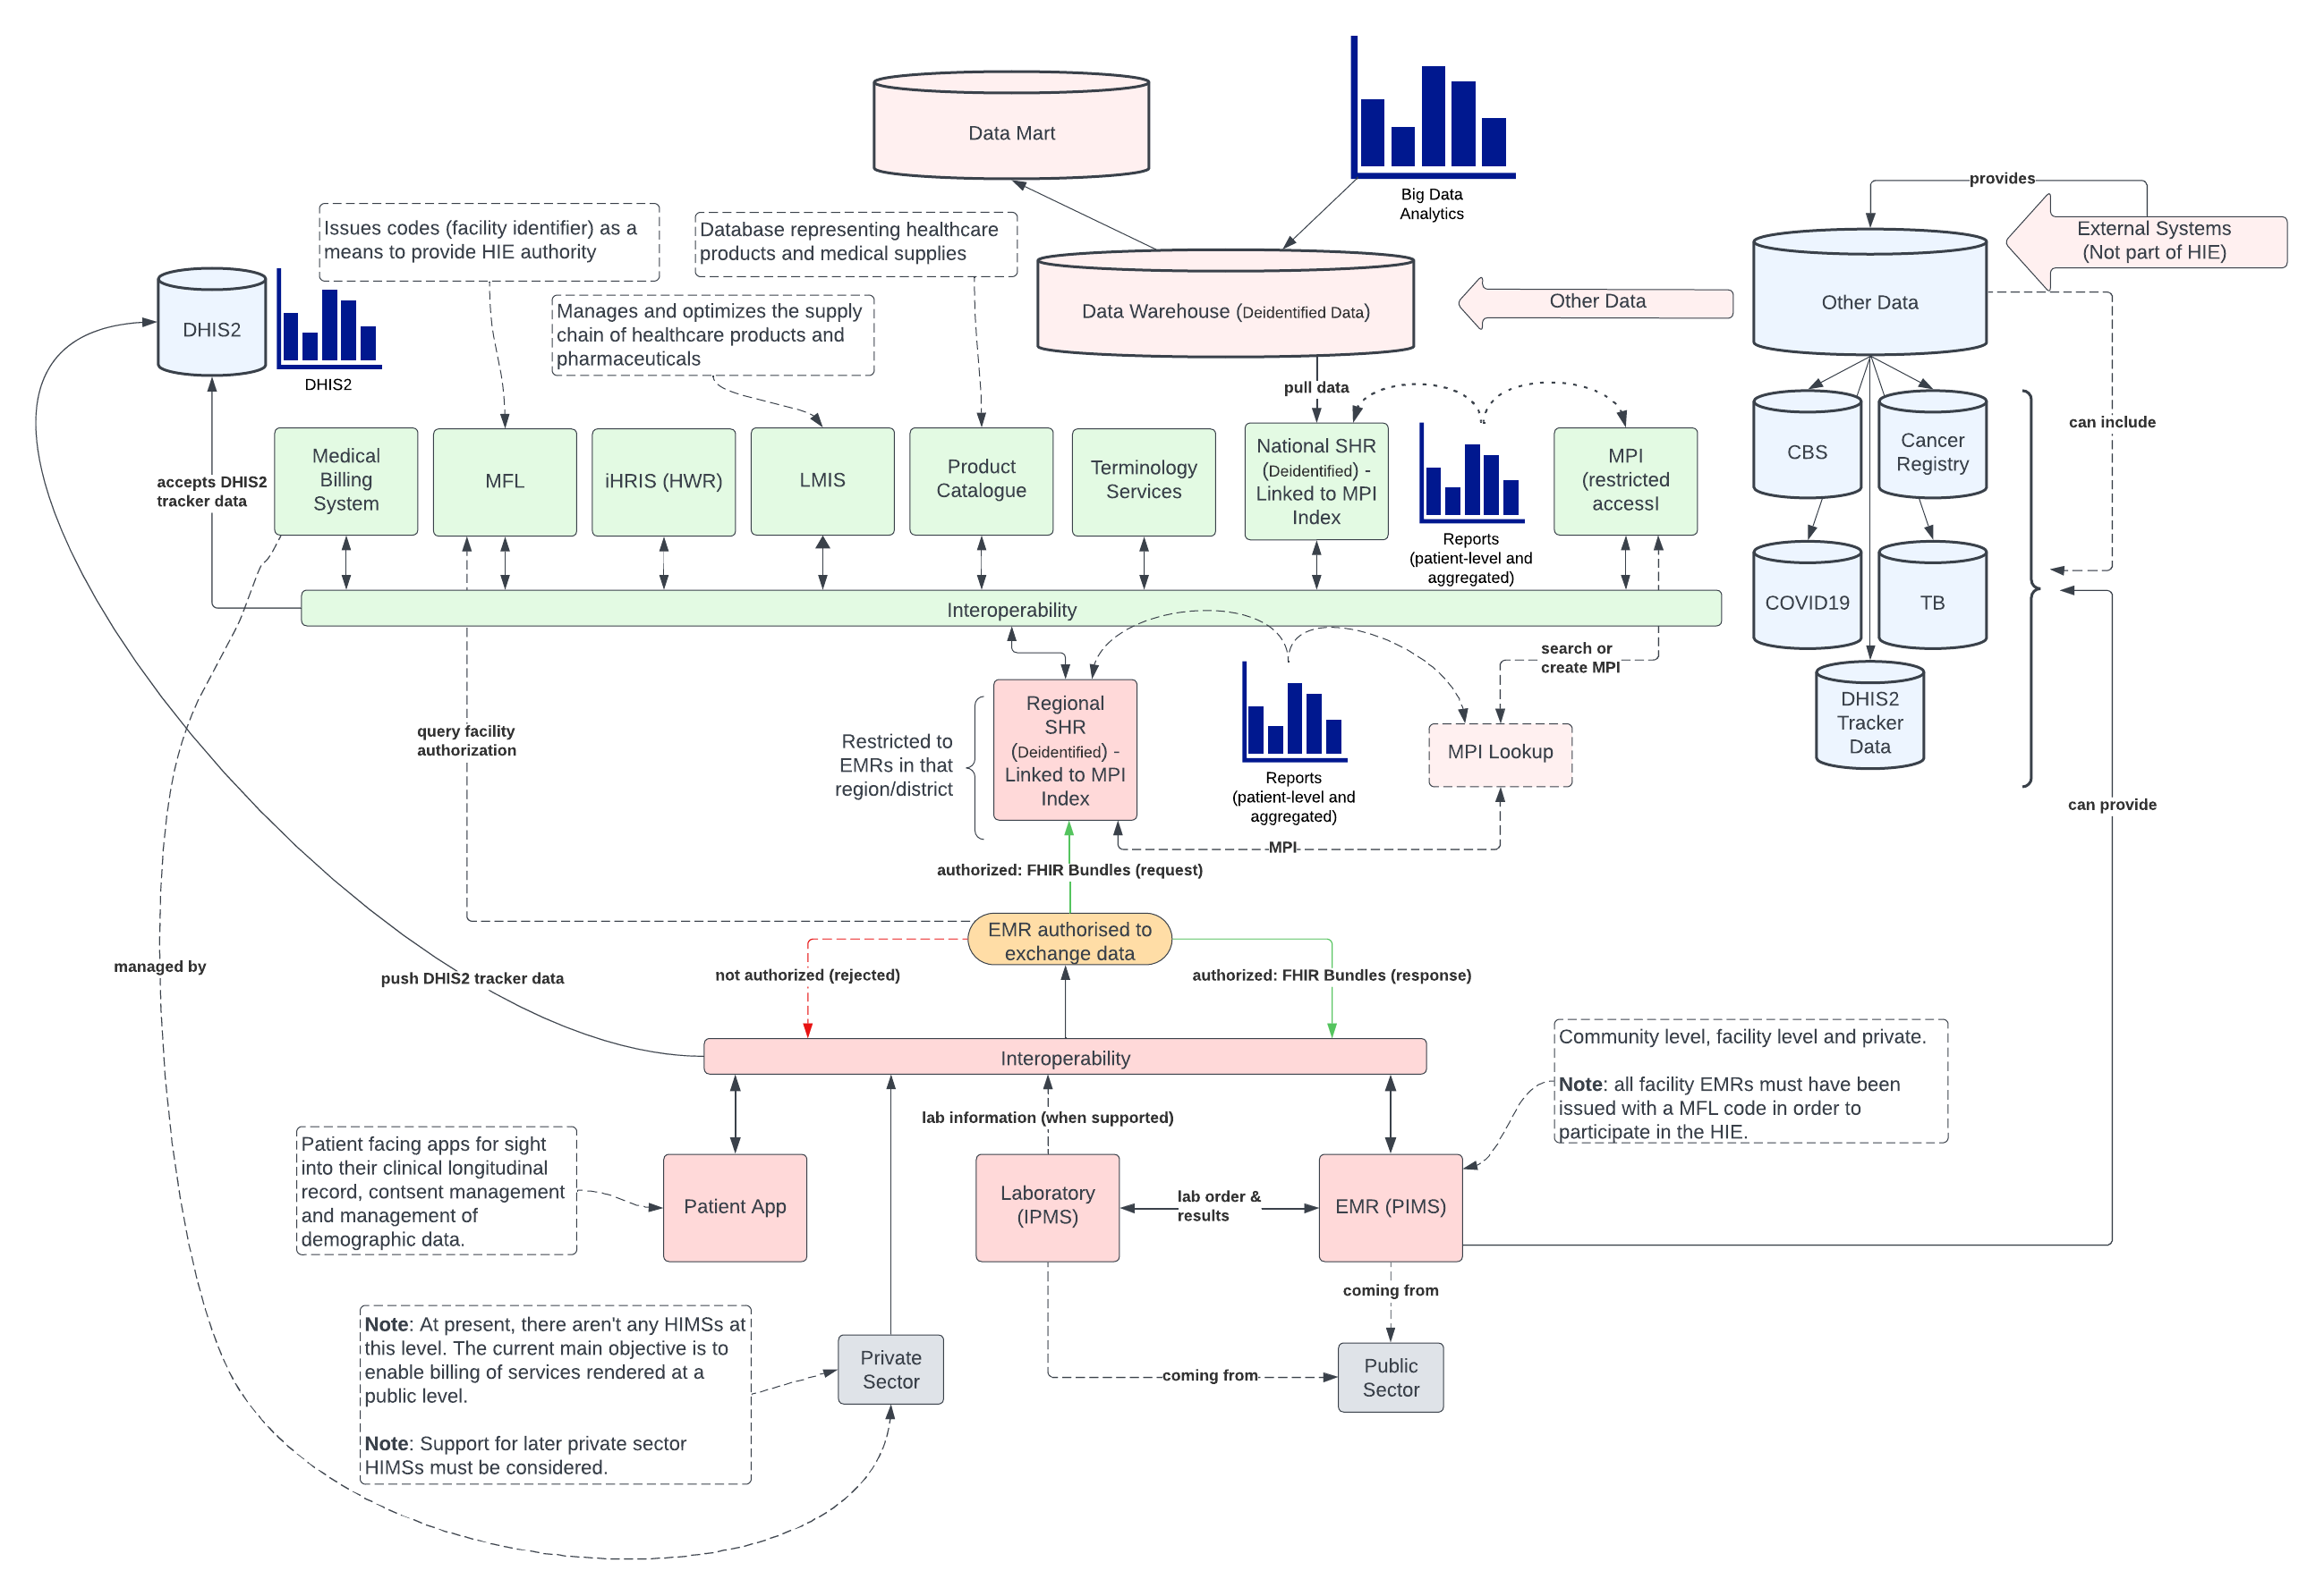

[ITI-91]
HMIS
[QRPH-58]
[QRPH-53]
ILR-FR
ILR-HWR
ILR/TS
ILR/TS
SHR
CR*
<map the investment rationale’s generic infrastructure design on top of a graphic of the country blueprint. See Botswana example – slide transition “morph” shows how one overlays the other and where spaces are left.>
TS*
[ITI-90]
[ITI-98:ITI-101]
[PCC-IPS]
[ITI-93]
[ITI-68]
[ITI-65]
ILR-ORG
[ITI-78]
CR
ATNA
The Botswanan EA can be modeled using this generic pattern, with a few differences.
[PCC-64]
[PCC-70]

Slide 46
A foundation of the investment rationale is that digital health will be leveraged to help systemically close the “know-do” gap.
Errors of
Omission
Everything that was done during a care encounter
The GREEN ZONE
Push the yellow circle. Increase the overlap.
Everything that should be done during a care encounter
Errors of Commission

Slide 47





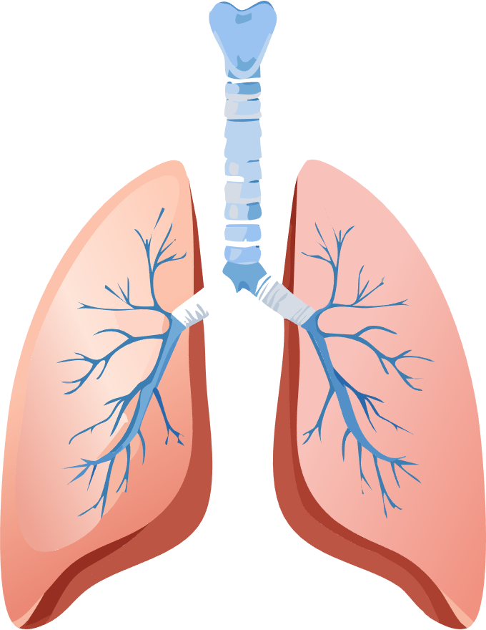




CCGs normatively define the minimum data set (MDS) needed to drive the guideline-based care and the care logic and reportable indicators that the MDS supports.
HIV / ANC / Immunization / etc…
Everything that should be done during a care encounter
Computable Care Guidelines
for HIV

Slide 48

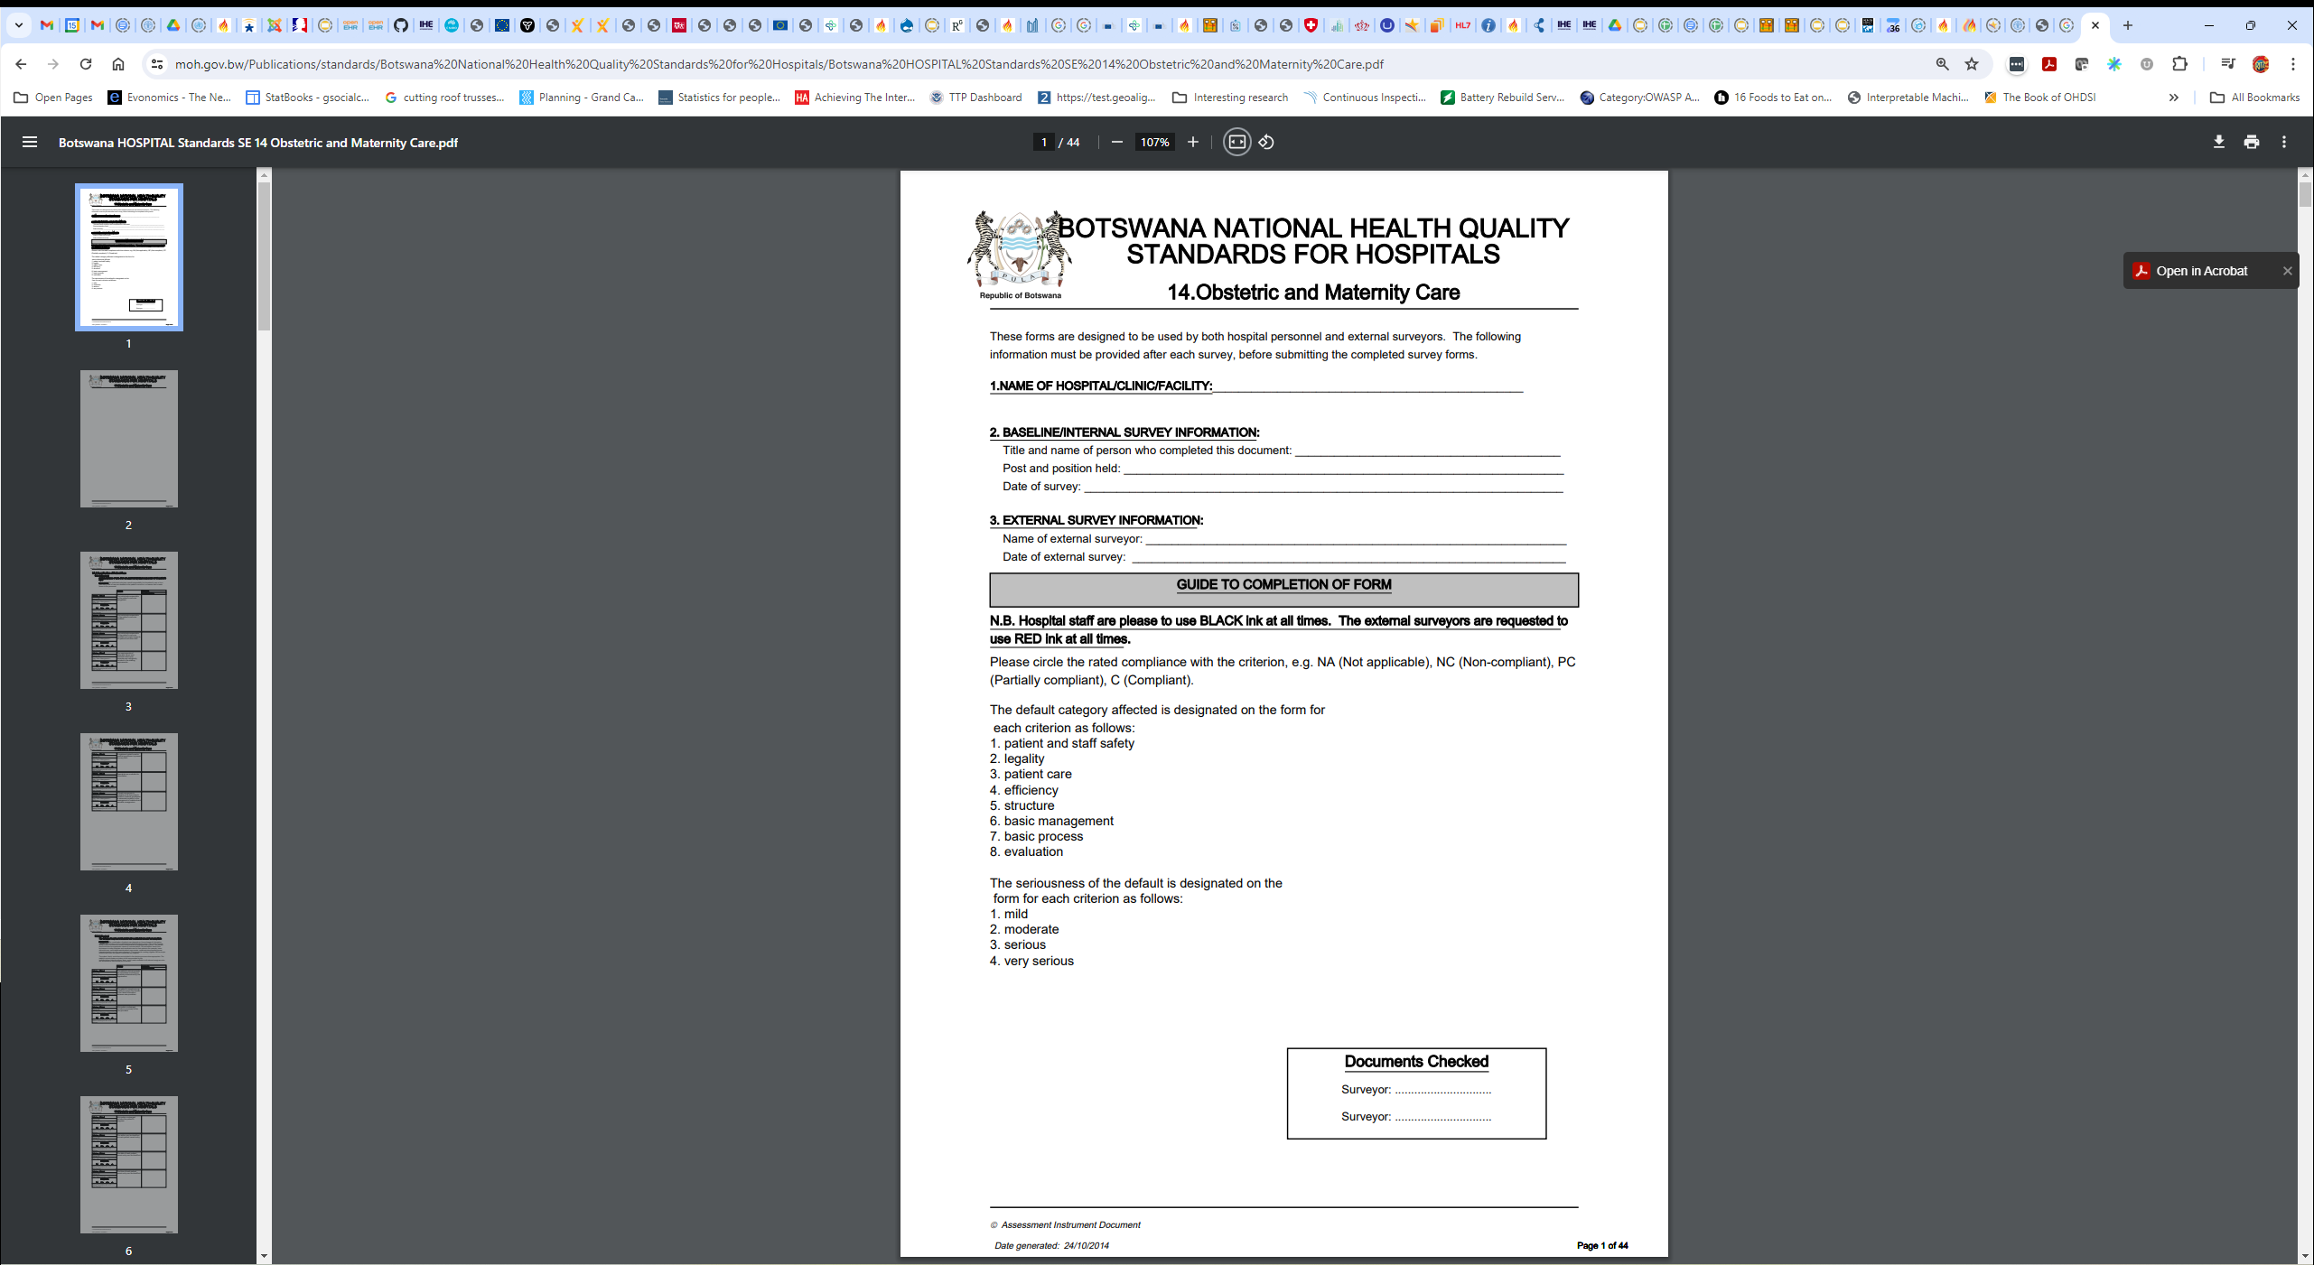









National Evidence-based
Practice Guidelines
Computable Care Guidelines (CCGs) operationalize evidence-based care and support care continuity through standards-based, person-centric digital health records.
Indicators support health system management. Advanced analytics inform improvements to the CCGs, themselves.
<example care guidelines (Botswana)… edit these, and country flag-map, as necessary>

Slide 49
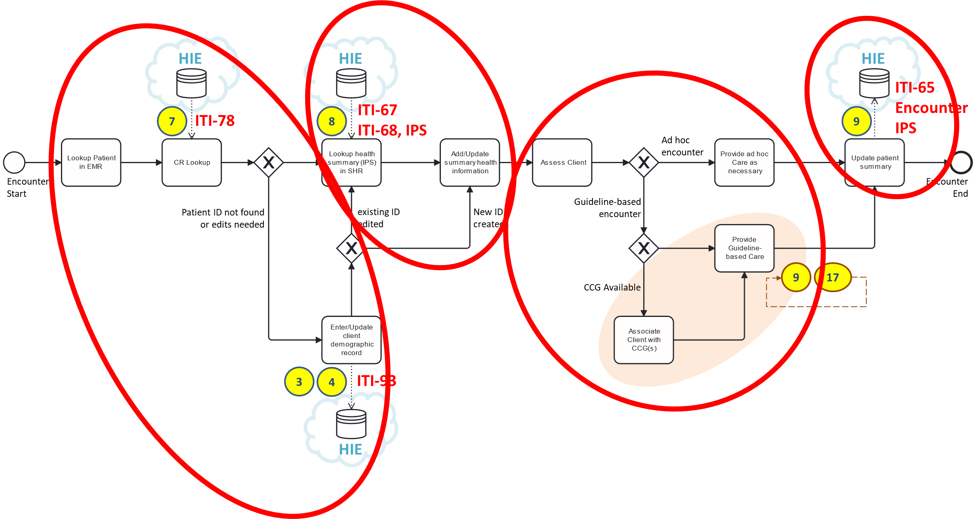

Normative POS behaviours can be thought of as a simple 1-2-3-4 pattern (like in a dance).
Unambiguously identify the subject of care.
Retrieve the subject’s health summary.
Update the subject’s health summary
Based on the summary, and on the current situation, provide appropriate care.

Slide 50



This pattern repeats.
At every care encounter…
Identify the person
Retrieve their health story (“IPS”)
Provide care
Update their IPS
1-2-3-4
1-2-3-4
1-2-3-4
VCCT clinic
Immunization clinic
District clinic
Care continuity is the key to achieving good outcomes at scale.

Slide 51
KEY TAKEAWAY POINTS
We will leverage digital health to systemically narrow the care delivery “know-do” gap (feedforward process control) and to operationalize a learning health system (feedback).
To mitigate risk, we expect to adopt a global portfolio of norms and standards, and to embrace proven, conformance-testable architectural patterns.
The Investment Rationale tool is predicated on this approach and these assumptions.
<add contextual point(s) regarding country blueprint alignment to investment rationale assumptions>

Slide 52

Questions and Answers?

Slide 53

LUNCH!
Notes:
Use this slide as a “break slide”

Slide 54

Based on GDHM, how ready are we to implement national-scale digital health infrastructure?

Slide 55
GDHM CONTENT
Navigate to the GDHM country page (e.g. for Botswana: https://monitor.digitalhealthmonitor.org/country_profile/BWA )
Capture content for each of the 7 axes of readiness assessment and paste, one axis per slide. Botswana example included.
Navigate to the GSMA country page for mobile phone coverage (https://www.gsma.com/coverage/) and select the target country. For each mobile operator, copy the coverage map onto a slide (one per operator). NOTE example coverage maps from Botswana.
Add a summary slide with “key takeaways” at the end.

Slide 56
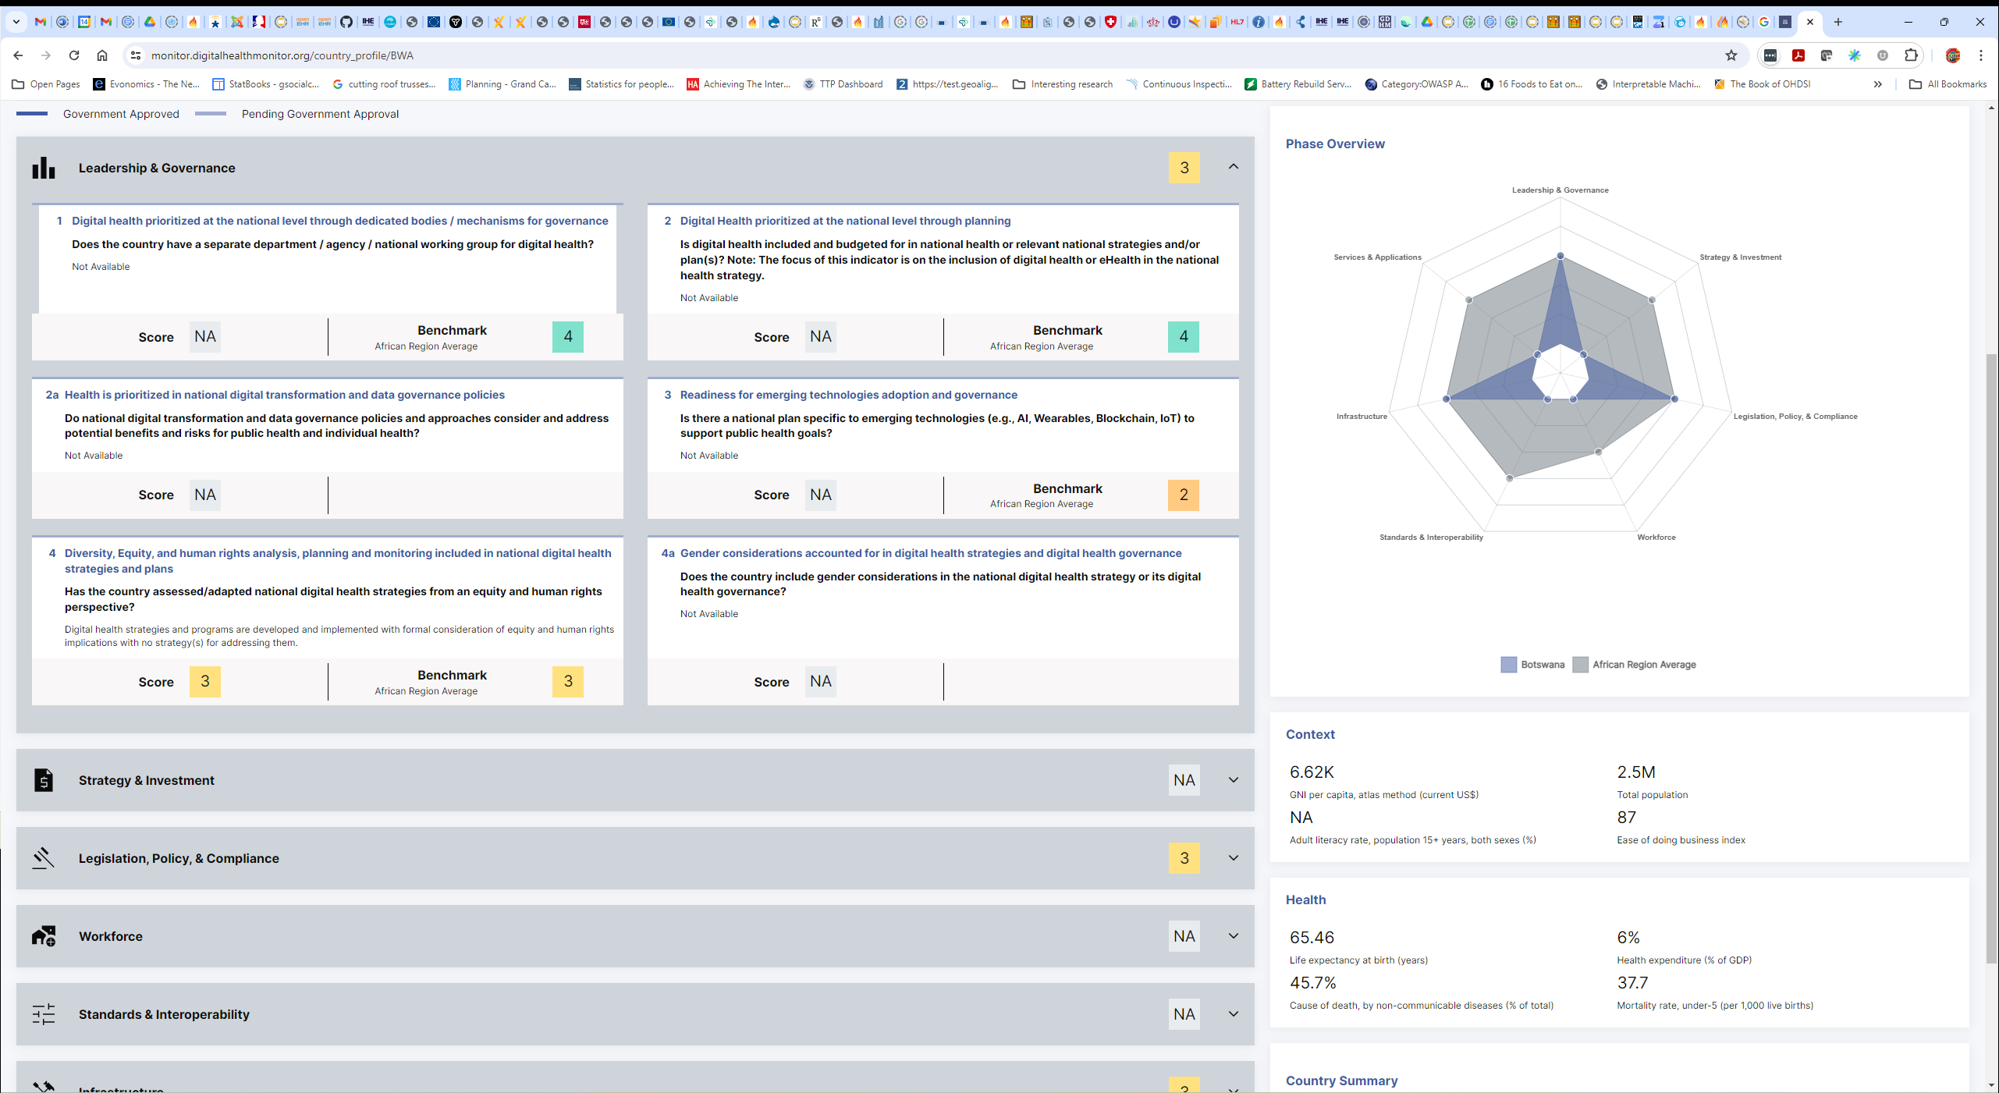
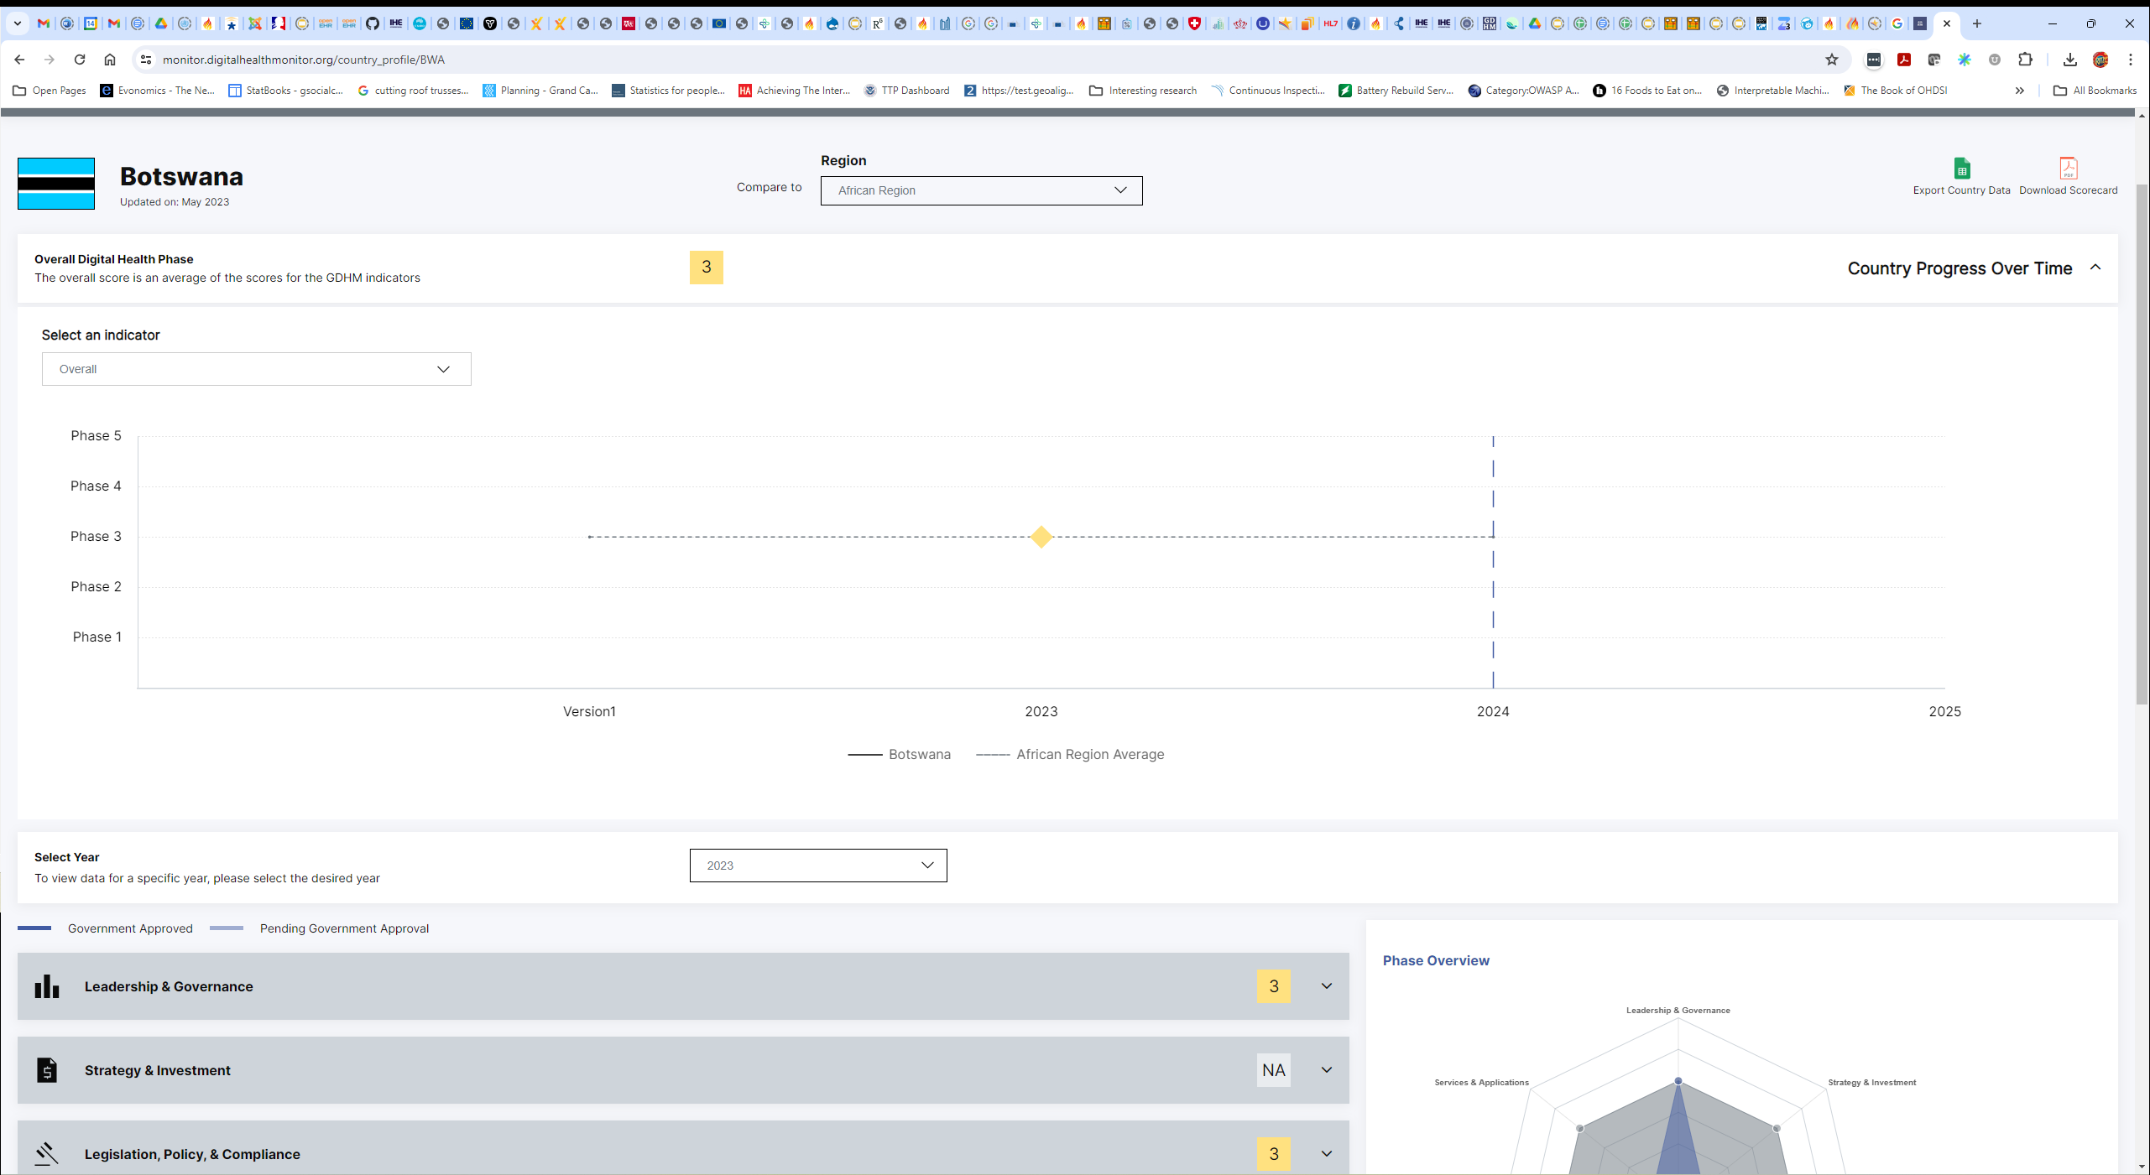
SUMMARY
https://monitor.digitalhealthmonitor.org/country_profile/BWA 2023 data

Slide 57
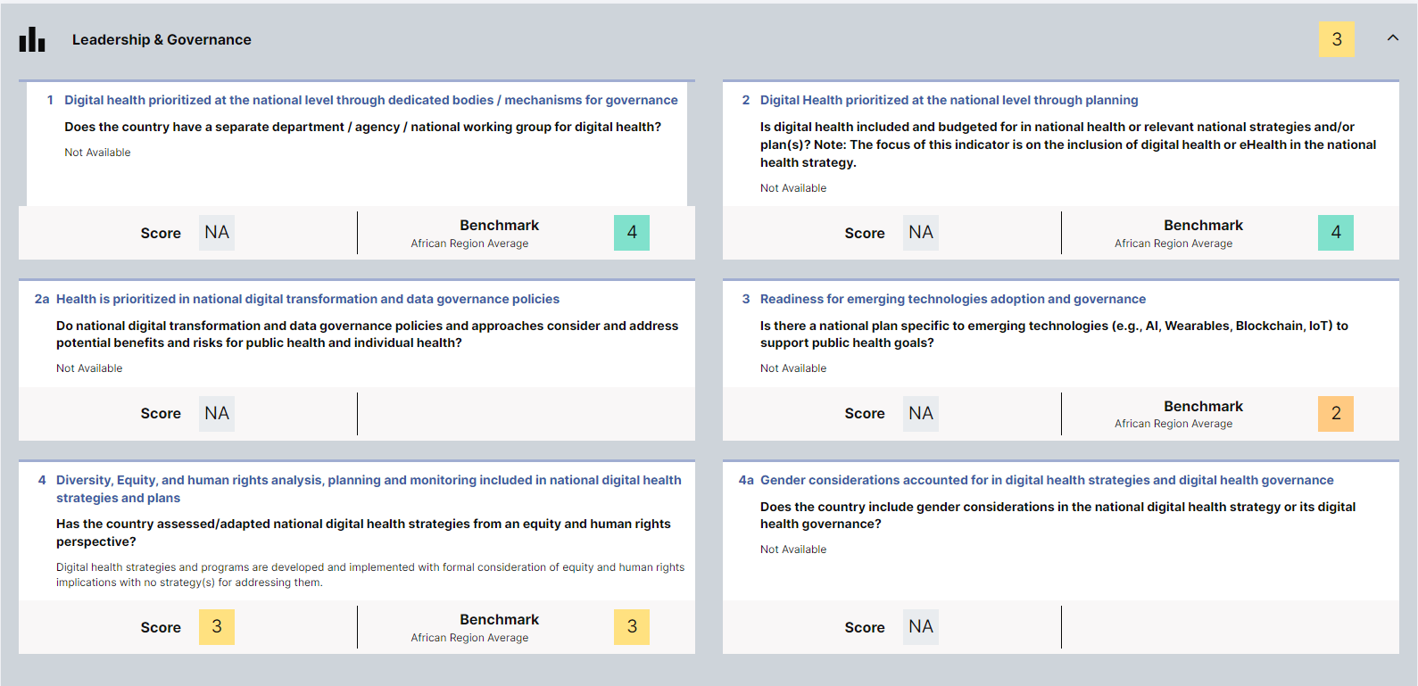
LEADERSHIP & GOVERNANCE
Digital health strategies and programs are developed and implemented with formal consideration of equity and human rights implications with no strategy(s) for addressing them.
https://monitor.digitalhealthmonitor.org/country_profile/BWA 2023 data

Slide 58
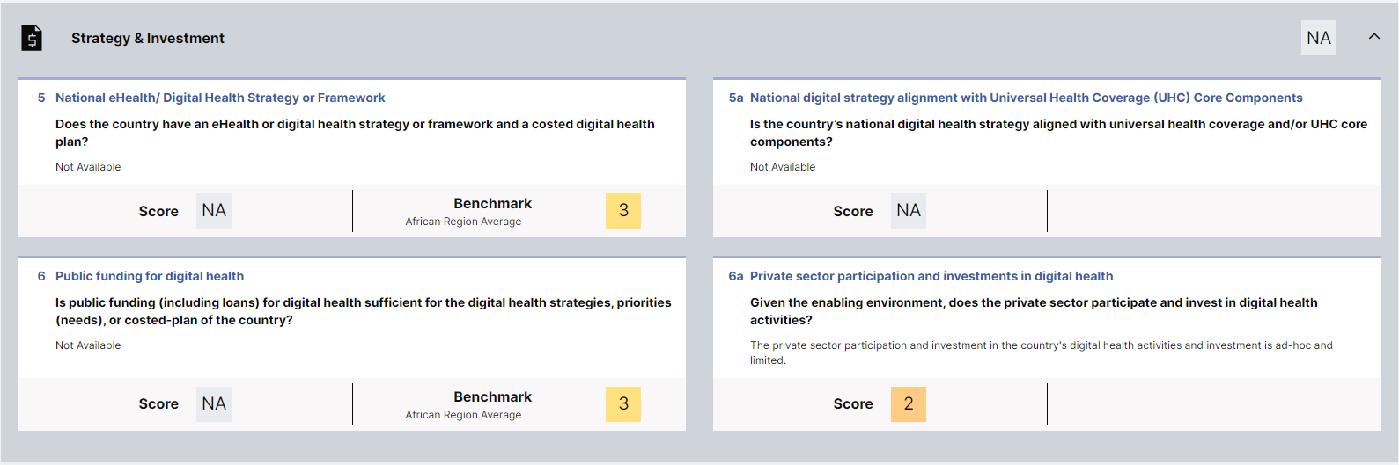
STRATEGY & INVESTMENT
The private sector participation and investment in the country's digital health activities and investment is ad-hoc and limited.
https://monitor.digitalhealthmonitor.org/country_profile/BWA 2023 data

Slide 59
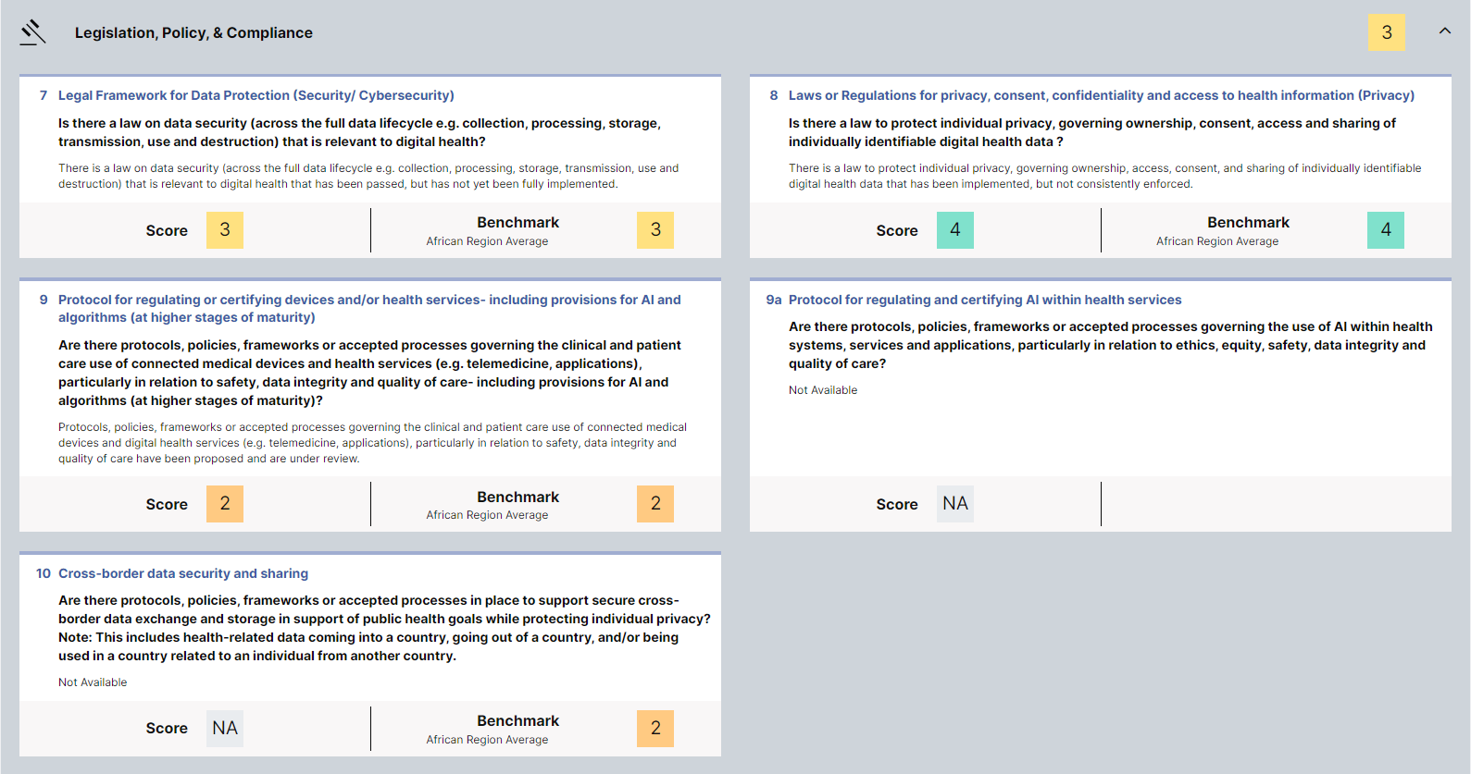
LEGISLATION, POLICY, & COMPLIANCE
There is a law on data security (across the full data lifecycle e.g. collection, processing, storage, transmission, use and destruction) that is relevant to digital health that has been passed, but has not yet been fully implemented.
There is a law to protect individual privacy, governing ownership, access, consent, and sharing of individually identifiable digital health data that has been implemented, but not consistently enforced.
Protocols, policies, frameworks or accepted processes governing the clinical and patient care use of connected medical devices and digital health services (e.g. telemedicine, applications), particularly in relation to safety, data integrity and quality of care have been proposed and are under review.
https://monitor.digitalhealthmonitor.org/country_profile/BWA 2023 data

Slide 60
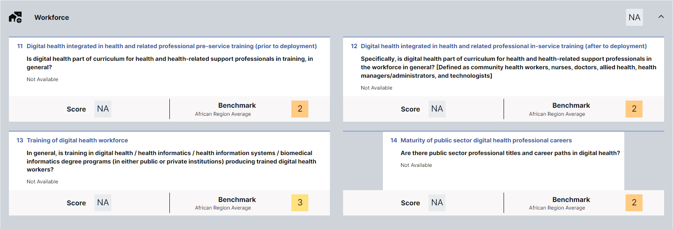
WORKFORCE
https://monitor.digitalhealthmonitor.org/country_profile/BWA 2023 data

Slide 61
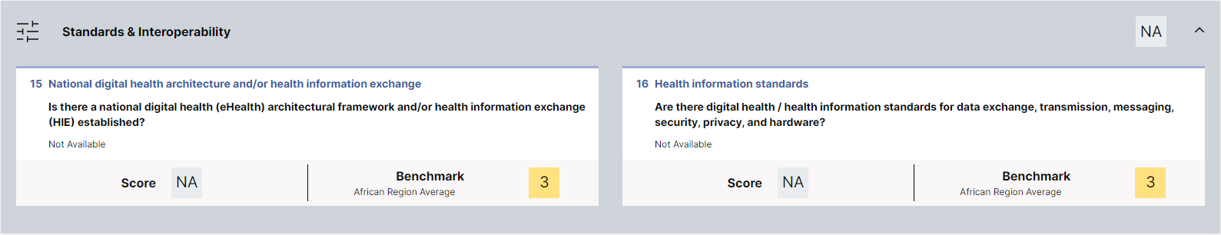
STANDARDS & INTEROPERABILITY
https://monitor.digitalhealthmonitor.org/country_profile/BWA 2023 data

Slide 62
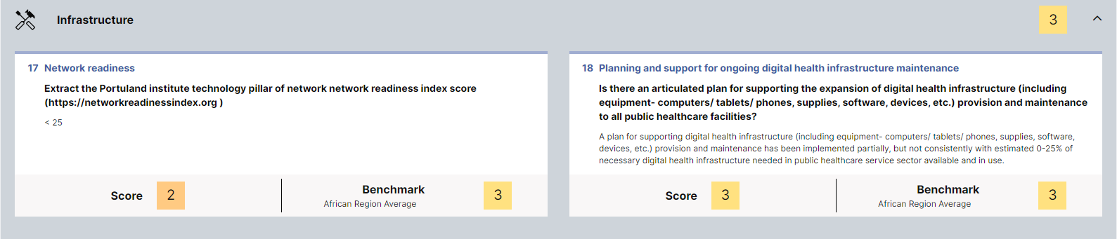
INFRASTRUCTURE
A plan for supporting digital health infrastructure (including equipment computers/tablets/ phones, supplies, software, devices, etc.) provision and maintenance has been implemented partially, but not consistently with estimated 0-25% of necessary digital health infrastructure needed in public healthcare service sector available and in use.
https://monitor.digitalhealthmonitor.org/country_profile/BWA 2023 data

Slide 63
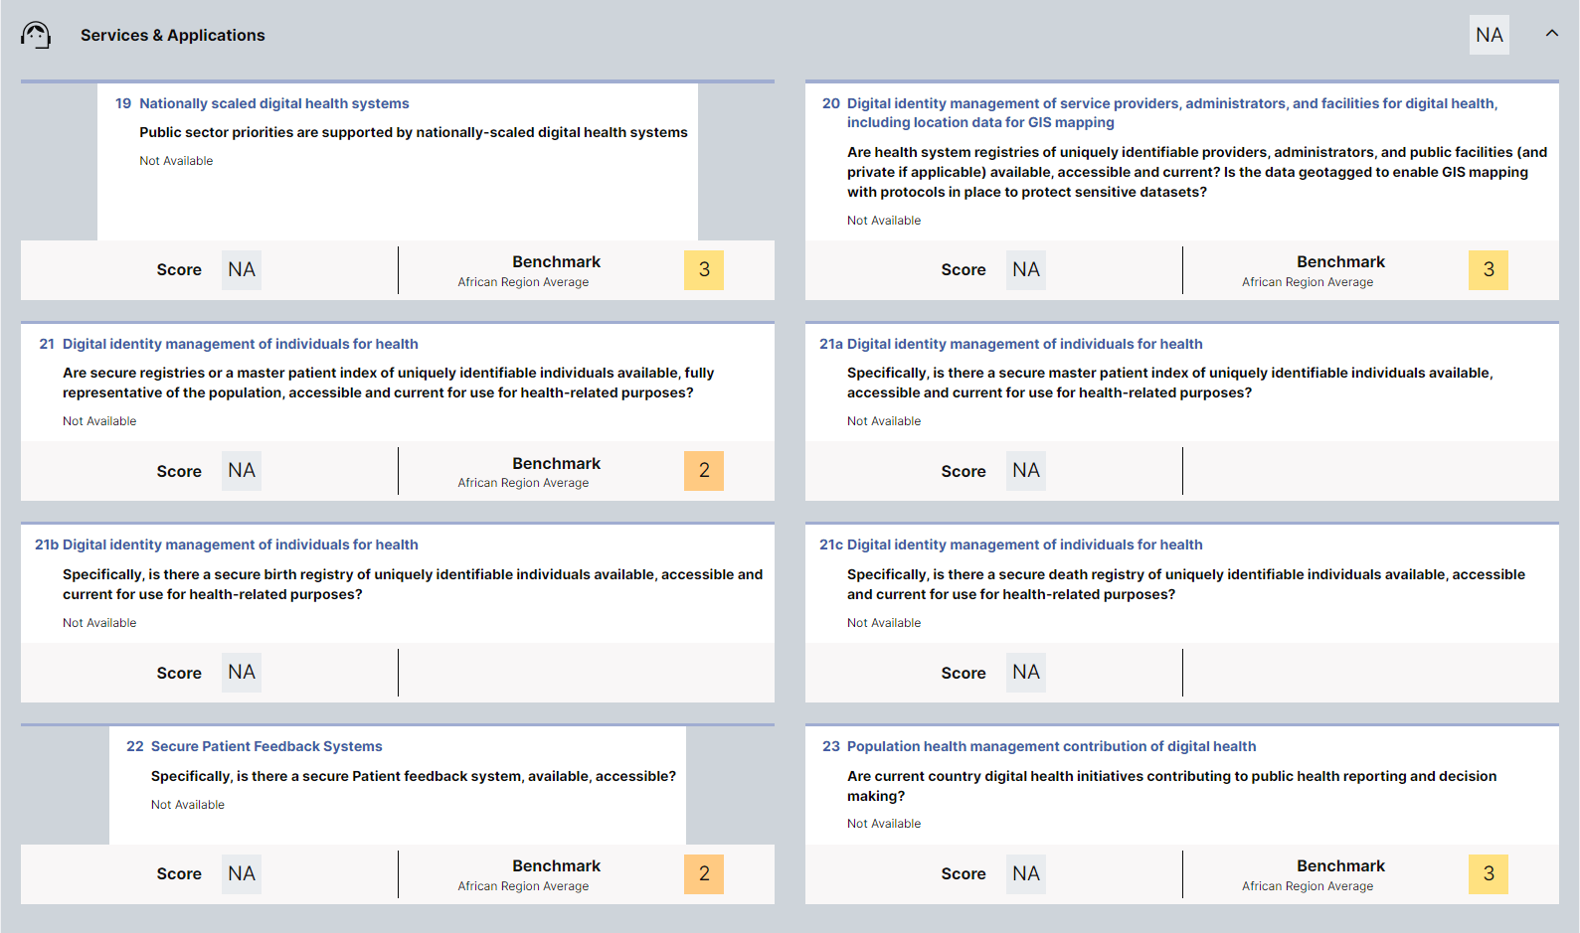
SERVICES & APPLICATIONS
https://monitor.digitalhealthmonitor.org/country_profile/BWA 2023 data

Slide 64
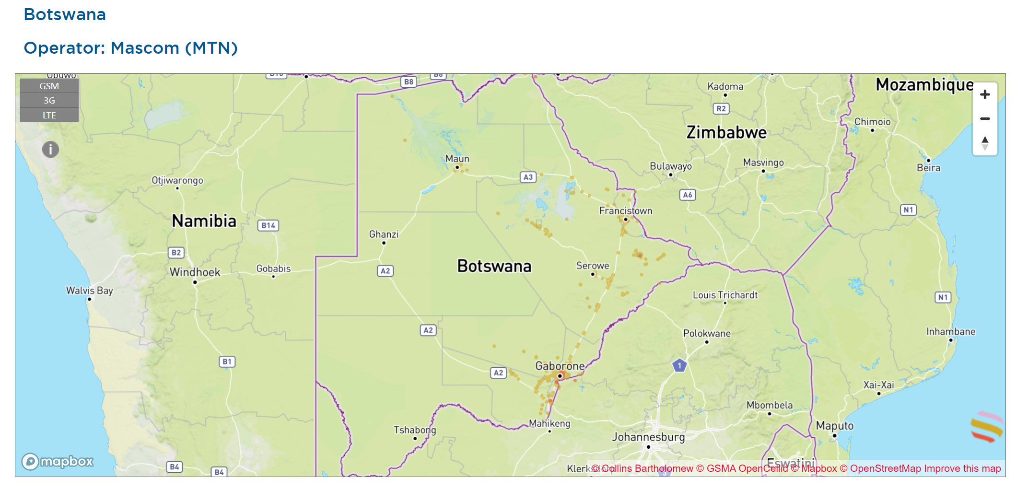
MOBILE NETWORK COVERAGE

Slide 65
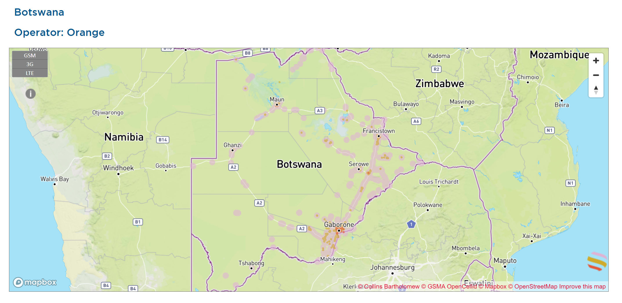
MOBILE NETWORK COVERAGE

Slide 66
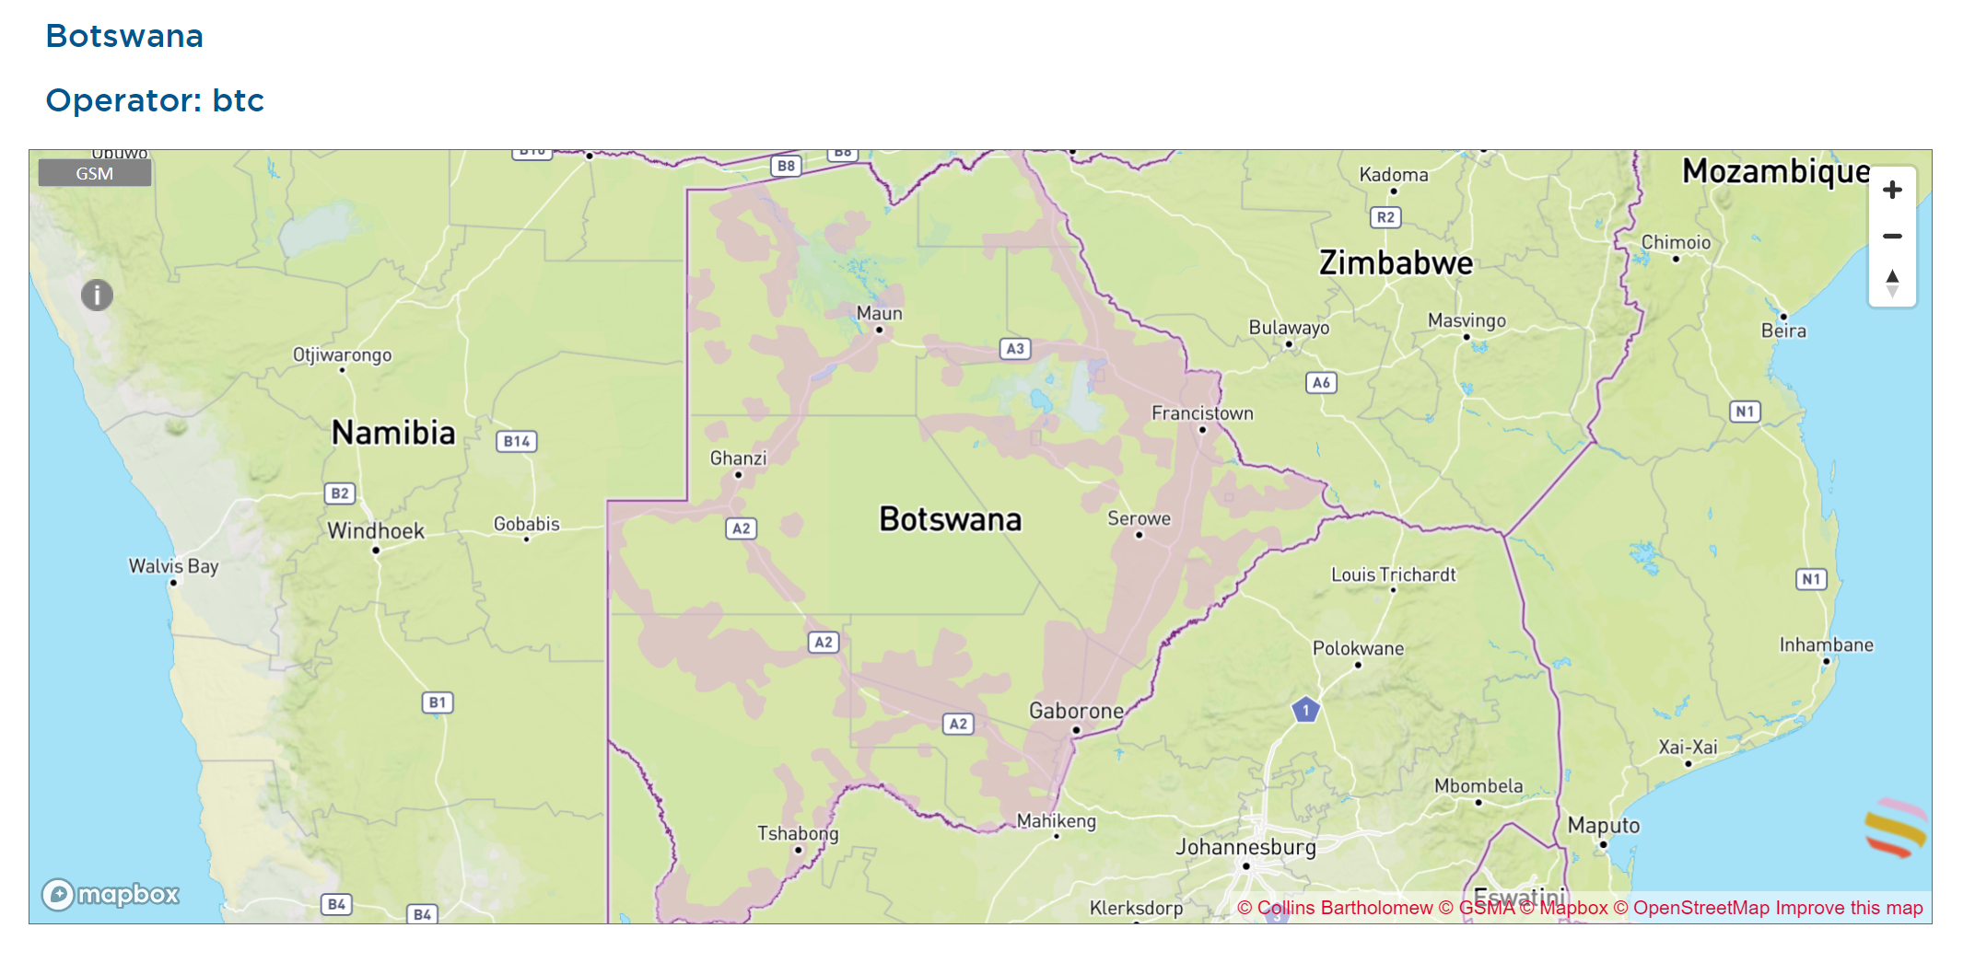
MOBILE NETWORK COVERAGE

Slide 67
KEY TAKEAWAY POINTS
Botswana’s readiness is generally consistent with its African peers. We have a Digital Health Phase score of 3 out of 5.
There are notable gaps in four key areas:
Strategy & Investment
Workforce
Standards & Interoperability
Services & Applications
The challenges are genuine. To succeed, any plan for national-scale implementation would need to address these gaps.

Slide 68
WORKSHOP AGENDA
Q1 – Official start & brief introductions / Overview of Present State [9-10:30am]
IHME Burden of Disease (BOD); Digital Health Monitor report; Published Health and Digital Health Strategies; Digital health implementations to date
Q2 – Archetypal “OpenHIE-on-FHIR” Blueprint [11am-12pm]
Architectural elements; Conformance-testable digital health “Lego® blocks”; Normative Point-of-Service (POS) system behaviours
Lunch [12-1pm]
Q3 – Mapping from Present State to Future State [1-2:30pm]
Existing Infrastructural Elements and “Gaps”; Key Infrastructure Design Choices; Implementation Science Approaches
Q4 – Developing an Investment Rationale in real time [3-5pm]
Filling in the remaining tabs on the Investment Rationale tool; Sensitivity analysis; Discussion; Meeting close and next steps

Slide 69

What Investment Rationale elements are germanely different from the present version of the EA?

Slide 70
COUNTRY BLUEPRINT GAP ANALYSIS
Identify areas where there are germane differences between the country’s blueprint and the Toolkit’s generic design (note: only focus on differences that impact the investment rationale).
Leverage relevant slides from section 3 of Toolkit deck “02 HIE Specifications” to describe relevant investment rationale assumptions not consistent with the country blueprint.
Display the country blueprint and call out the areas where discussion will be needed during the real-time data entry in the investment rationale tool.
Add a “key takeaways” slide to summarize findings.
Note Botswana example…

Slide 71
HWD
FD
ORG
Interoperability Layer
(16)
(16)
(16)
(16)
OLTP FHIR Server
(2)
TS*
(5)
ILR/TS
ILR-HWR
ILR-FR
ILR-ORG
SHR
HMIS
CR*
CR
(7)
(10)
(11,12,13,14)
(10)
(10)
(10)
(8)
(9)
(9*)
(15)
(7)
ATNA
(8)
(9)
(10)
(11,12,13,14)
(15)
(1)
(3)
(4)
(Maintenance/batch transactions)
(Real-time runtime transactions)
CR*
POS
(6)
POS
Solution
(9)
CCG
Engine
(17)

Slide 72

HWD
FD
ORG
Interoperability Layer
(16)
(16)
(16)
(16)
OLTP FHIR Server
Terminology Publishing. A terminology server (TS*) will be employed to curate and cross reference the national lists of normative codes. As part of a regular refresh process, the MOH will publish updated code lists and make these available so that digital health POS solutions can update their code lists. This is illustrated by transaction (1). As shown by transaction (2), these published terminologies will also update the runtime code lists maintained in the OLTP-optimized FHIR Server. NOTE: it is common for such publishing processes to employ Excel and/or PDF files as the means of distributing code lists. Each POS solution will be required to be able to ingest the published format. The interactions with the TS* may be managed via the Interoperability Layer.
(2)
TS*
(5)
ILR/TS
ILR-HWR
ILR-FR
ILR-ORG
SHR
HMIS
CR*
CR
(7)
(10)
(11,12,13,14)
(10)
(10)
(10)
(8)
(9)
(9*)
(15)
(7)
ATNA
(8)
(9)
(10)
(11,12,13,14)
(15)
(1)
(3)
(4)
CR*
POS
(6)
POS
Solution
(9)
CCG
Engine
(17)

Slide 73
HWD
FD
Manage Client Registry Records. It is expected that there may be a ceremony associated with managing Client Registry records. A barcoded unique ID card may be issued, as an example, that will associate the client’s demographic information with their unique health identifier. As part of maintenance, duplicate client records that have been created in error will need to be de-duplicated (and the underlying IDs merged). These processes may be operationalized by every POS, or there may be a specialized solution (CR* POS) that is dedicated to efficiently and correctly executing client record ID-management, including the “new client ID” ceremony. The CR* POS will need to support both adding and updating client demographic records, as illustrated by real-time transactions (3) and (4). The CR* server will need to be able to sync new or updated client demographic records to the HIE’s OLTP-optimized FHIR Server, as shown in transaction (5). If there is a separate CR* POS, and if an offline mode must be supported, there may be a sync transaction between a POS Solution and the dedicated CR* POS application. This is shown as transaction (6). NOTE: the CR* POS’ interactions with the CR* may be managed via the Interoperability Layer.
ORG
Interoperability Layer
(16)
(16)
(16)
(16)
OLTP FHIR Server
(2)
TS*
(5)
ILR/TS
ILR-HWR
ILR-FR
ILR-ORG
SHR
HMIS
CR*
CR
(7)
(10)
(11,12,13,14)
(10)
(10)
(10)
(8)
(9)
(9*)
(15)
(7)
ATNA
(8)
(9)
(10)
(11,12,13,14)
(15)
(1)
(3)
(4)
CR*
POS
(6)
POS
Solution
(9)
CCG
Engine
(17)

Slide 74
Execute Computable Care Guideline (CCG) Processing. Transaction (9) is employed, during an encounter, to launch the processing of one or more CCGs. A POS solution provides a CCG Engine actor with the client’s current IPS using transaction (9) and invokes a $apply operation using transaction (17). Relevant guideline-based care recommendations are returned from the CCG Engine actor and processed by the POS solution. Actions that operationalize the CCG-based recommendations (e.g. measure and record blood pressure, order medications, etc.) are reflected in the client’s real-time IPS. Over the course of the encounter, the transaction 9-17 pattern is repeated until no further recommendations are returned from the CCG Engine.
HWD
FD
ORG
Interoperability Layer
(16)
(16)
(16)
(16)
OLTP FHIR Server
(2)
TS*
(5)
ILR/TS
ILR-HWR
ILR-FR
ILR-ORG
SHR
HMIS
CR*
CR
(7)
(10)
(11,12,13,14)
(10)
(10)
(10)
(8)
(9)
(9*)
(15)
(7)
ATNA
(8)
(9)
(10)
(11,12,13,14)
(15)
(1)
(3)
(4)
(Maintenance/batch transactions)
(Real-time runtime transactions)
CR*
POS
(6)
POS
Solution
(9)
CCG
Engine
(17)

Slide 75

TS*
CR*
CR*
POS
ATNA
CCG
Engine
To be discussed in Q4.

Slide 76
KEY TAKEAWAY POINTS
The “generic” Investment Rationale architecture is more similar to Botswana’s EA than it is different.
Key functionalities which will need to be modeled during Q4 of the workshop will include:
How will regular terminology updates be communicated to POS solutions?
How will new demographic records for health be created and what will be the “wallet ID”?
Will we adopt CCGs? If not, how will we realize impact, and how much impact can we gain?

Slide 77

What are our current health and digital health strategies?

Slide 78
HEALTH & DIGITAL HEALTH STRATEGIES
Obtain the MOH’s most recent health & digital health strategies
Capture key points from these strategy documents. Particularly call our where there has been a focus on M&E vs on care delivery. Note relevant elements of strategy particularly focused on interoperability, HIE, etc.
Summarize on a “key takeaways” slide. Compare and contrast the strategies. Are they current? Are they aligned to the burden of disease… and to each other?
NOTE example from Botswana…

Slide 79

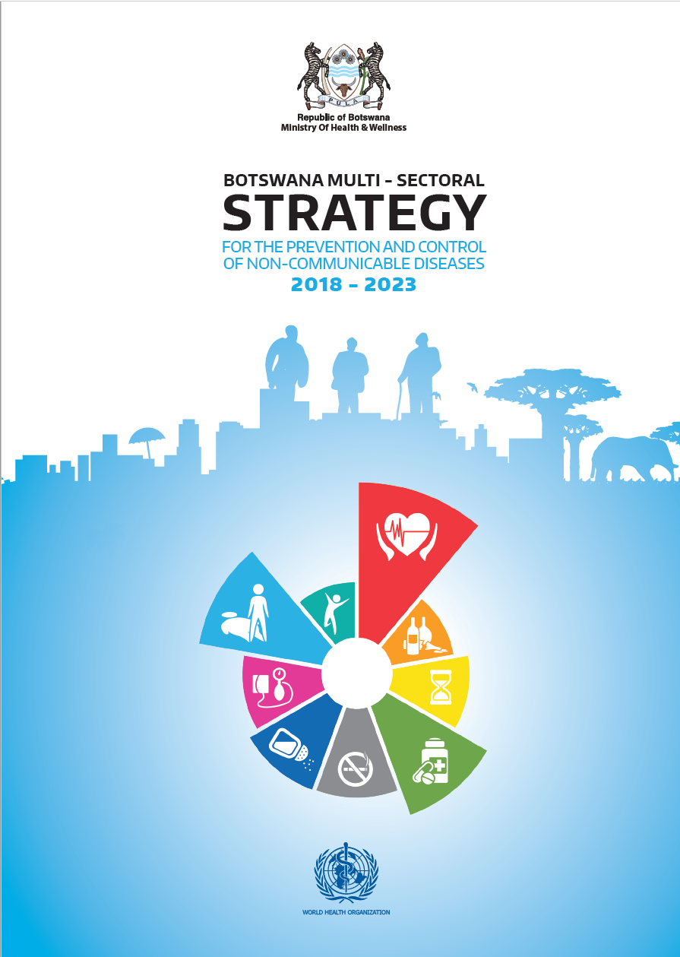
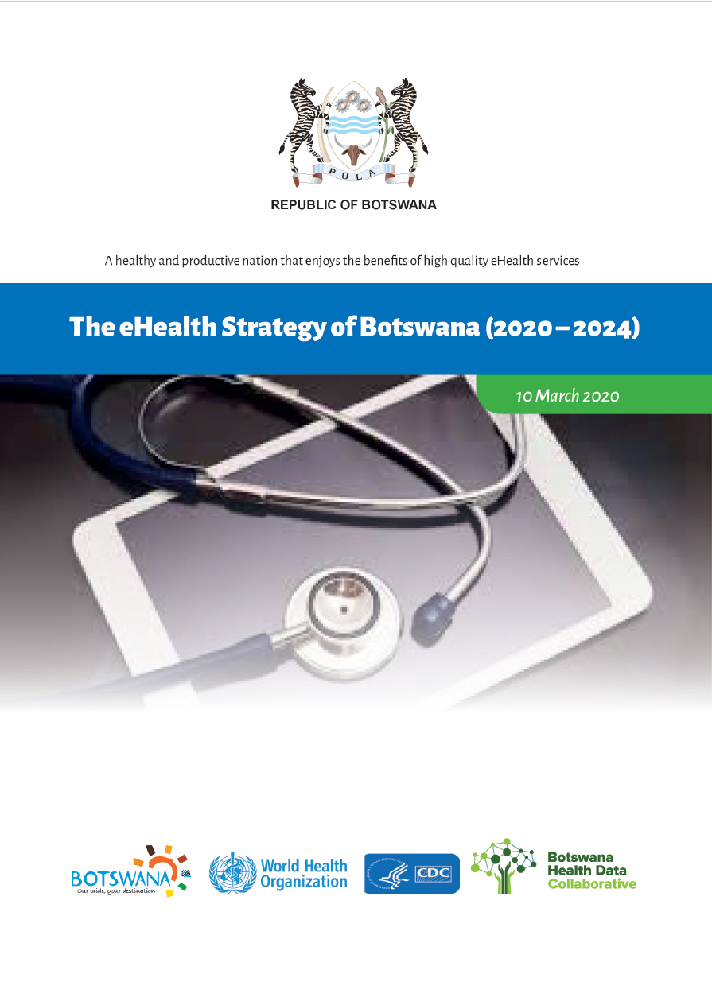
November 2010
January 2018
March 2020

Slide 80
“Health service delivery in the country is pluralistic. There are public, private for-profit, private non-profit, and traditional medicine practices. The Ministry of Health (MOH) is responsible for the formulation of policies, regulation and norms, and standards and guidelines for health services. Government has achieved the Abuja target of contributing 15% of total government expenditure to health (representing around 75% of total health expenditure). With the relocation of primary health care from the Ministry of Local Government (MLG), the MOH is now the principal public sector health care provider.”
“Health management information is weak. Challenges include untimely data collection, collation, analysis, interpretation, and dissemination of information. The situation in compounded by the existence of several databases (epidemiology, human resources, finance etc) existing in parallel. Monitoring and evaluation is fragmented; as a consequence, tracking health outcomes, and measuring the impact of specific interventions is compromised.”
November 2010

Slide 81
Objectives of the IHSP
“The goal of service delivery is the attainment of universal coverage of a high-quality package of essential health services, EHSP, through:
Scale up of utilisation of a well defined and comprehensive essential health service package;
Redefining existing service delivery levels and delineating types of health services for each of these levels of the health care to ensure continuity and harmonised referral and supervisory functions;
Increasing and strengthening partnerships with the private sector and NGOs
Community involvement to ensure effective demand for health services
Promoting community participation in the planning and delivery of health services.”
November 2010

Slide 82
Objectives of the IHSP
“The Health Information and Research goal is to create an enabling environment for efficient monitoring and evaluation of the implementation and achievements of the integrated health service plan and to provide the basis for evidence-based decision-making. The objectives are:
To collect and analyse health information about diseases, services, finances, health workforce, medicines and medical products, infrastructure and equipment from all stakeholders of the health sector.
To clarify the roles and functions of different stakeholders in data management in order to minimise duplication and maximise optimal utilization of resources
To ensure timely, wide, and need-based dissemination of data to all stakeholders.
To develop and implement a research agenda in collaboration with relevant partners to support national policy development
To develop and implement regulations regarding mandatory reporting of defined information requirements
To develop, implement and enforce regulatory mechanism for health research.”
November 2010

Slide 83
“This national strategy will focus on the four major NCDs, which account for 82% of NCD-related deaths (cancers, cardiovascular diseases, diabetes, chronic respiratory disease), as well as the four common modifiable risk factors they are associated with (smoking, harmful use of alcohol, unhealthy diet, and physical inactivity). Broader definitions of NCDs are recognised, including injuries and mental illness, as well as those conditions referred to in the Brazzaville Declaration (hemoglobinopathies, oral disease, eye disease, rheumatic heart disease). While these conditions are important, the approach taken in this strategy was to maintain a narrow focus in order to address the areas of highest burden and areas with the greatest gaps, and facilitate effective implementation of their ‘best buys’ interventions.”
Top-4 NCD causes of death from IHME (2021):
#3 Stroke
#5 Ischemic Heart Disease
#8 Diabetes
#10 Hypertensive Heart Disease
January 2018

Slide 84
“…[M]any individuals who have an NCD are undiagnosed and unaware of it. The STEPS 2014 survey revealed that 23% of those with hypertension were not aware and not on treatment. Furthermore, 70% of cancers reported nationally with staging information available are diagnosed at advanced stage. This limits the impact of treatment and the chances of long-term survival.”
January 2018

Slide 85
“The rising burden of NCDs in the country is of great concern to the Government of Botswana and is a threat to the achievement of the Sustainable Development Goals 2016-2030 and Vision 2036. The prevention and control of NCDs has been prioritised and included in high-level national strategy documents such as the 11th National Development Plan (2017-2023), Ministry of Health and Wellness strategy 2017-2023 and the National Essential Health Services package.
NCD diagnosis and management has also been incorporated into the National Strategic Framework III for HIV/AIDS. Finally, a national harmonisation of community-based interventions in health is underway, which will include standardised basic NCD prevention and control services offered by community health workers.”
January 2018

Slide 86
March 2020

Slide 87
March 2020

Slide 88
KEY TAKEAWAY POINTS
Botswana’s strategic health focus is broadening (since 2010) to address the growing NCD burden.
Driven by UHC goals, a package of basic health services has been defined, largely to be delivered in primary or community care settings.
More recently, the digital health focus has shifted from M&E-only toward broader support of care delivery workflows executed at the point of service.
Care continuity is recognized as important. Health data sharing infrastructure has been identified as a strategic initiative to help address it.
Botswana needs a national digital health “blueprint”, including national norms and standards.

Slide 89

What are some implementation science aspects that can significantly impact the Investment Rationale?

Slide 90
IMPLEMENTATION SCIENCE
Leverage content from Toolkit deck “04 Implementation Science” to underscore important concepts that drive choices in the Investment Rationale spreadsheet.
This section is pedagogical – some or all of it may be omitted if it is clear that it would not benefit the country MOH team.
See Botswana example…

Slide 91

There are two key elements of personal health data policy:
Health data governance policy
Health data sharing policy

Slide 92
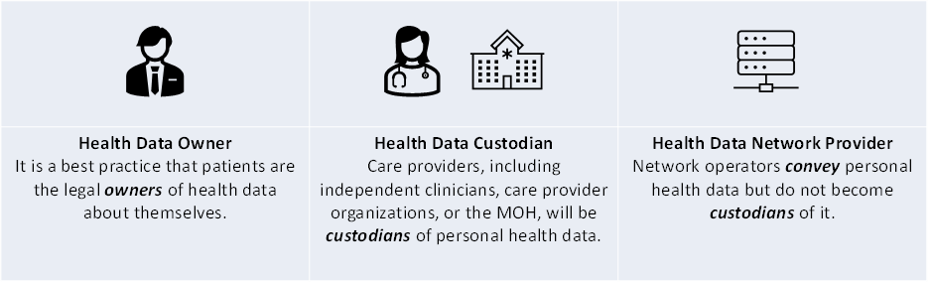
TYPICAL REGULATED ACTORS
Typically, as the owner of data about himself or herself, a subject of care should have a right to access their own data and may share their personal health data with whomever they choose. This right applies to digital data in the same way as it would apply to paper copies of personal health data.
Health data custodians are generally required to safeguard data holdings, ensure they are available when they need to be, and ensure they are only used by authorized persons for authorized purposes. All healthcare providers are health data custodians.
Network providers are typically required to ensure the integrity of the content they convey and to ensure that their operational processes do not inadvertently create data holdings that would cause them to become a custodian.

Slide 93
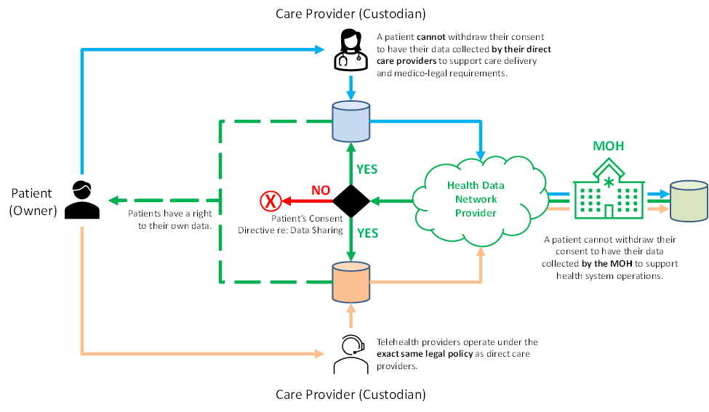
DATA SHARING

Slide 94
IMPORTANT DEFINITIONS
Opt-in – a client must explicitly give informed consent. Without this consent, their health data is not shared.
Opt-out – unless a client explicitly withdraws their consent, their health data is shared.
BTG – a care provider may, with explicit reasons given and logged, override the client’s consent option (“break the glass”).
Circle of Care – the scope of a client’s consent is applied to care providers in their circle of care. This circle can be broadly defined (entire care network) or narrowly (explicit list of care providers).
Purpose of Use – the scope of a client’s consent will apply to select purposes. Commonly, care delivery is the only permitted use unless other purposes are specifically consented to (e.g. clinical trial, research, etc.).

Slide 95
DATA SHARING RECOMMENDATION
For implementability, an opt-out/no-BTG/whole-network/care-purpose consent policy is highly recommended:
By default, a patient’s data will be shared within the entire care delivery network for the purpose of delivering care with no overrides.
A person must have the right to withdraw their consent to have their data shared. They cannot withdraw their consent to have their data collected.
As a matter of governance, and to fulfill its fiduciary duties, the MOH (via the HIE) should be legislated as a mandatory custodian.
By default, and with only a few exceptions, a Custodian should permit a person to have access to their own health data.

Slide 96
DATA SHARING
As a matter of fiduciary duty, all patient data should be persisted to the MOH’s HIE.
National
HIE
To support care quality and patient safety, the recommended default is to share unless a person has explicitly withdrawn their consent.
As a practical matter, the MOH may decide to operate a patient portal.

Slide 97
DATA BLOCKING
Many jurisdictions have struggled with challenges of private sector care provider data blocking – where patient health data is intentionally not shared to the HIE.
It can be useful to frame this as a patient rights issue. Each person has a right to patient-safe, high-quality care; this right relies on their health data being shared within the care delivery network.
National legislation defending patient quality of care can serve as anti-data-hoarding legislation.

Slide 98

SYSTEMS ENGINEERING PRINCIPLES
Optimize the design around the systemic default use cases.
Introduce exception-based processing as needed.
Exceptions are not allowed to break the system.
Any proposed exceptions to the data-sharing policies should be mindful of these principles.

Slide 99
KEY TAKEAWAY POINTS
There must be an enforceable legal basis for a national-scale health data sharing infrastructure. This legal basis must apply equally to both the public and private sector.
Different custodial rights and obligations will apply to different health system actors.
HIE operations must abide and should enforce the legal basis for data sharing.
If consent to share cannot be withdrawn there is no privacy. It is not possible/practical to withdraw consent to collect health information.
An opt-out consent policy is strongly recommended.

Slide 100
MANAGEMENT PRINCIPLES
As a practical matter of cost-efficiency, it is important to coordinate the efforts of all relevant digital health stakeholders.
As a practical matter of HIE governance, all digital health initiatives need to be adherent to the national digital health norms and standards.
As a matter of sovereignty, initiatives should serve the national health and digital health strategies (noting the Paris Declaration on AID Effectiveness).

Slide 101
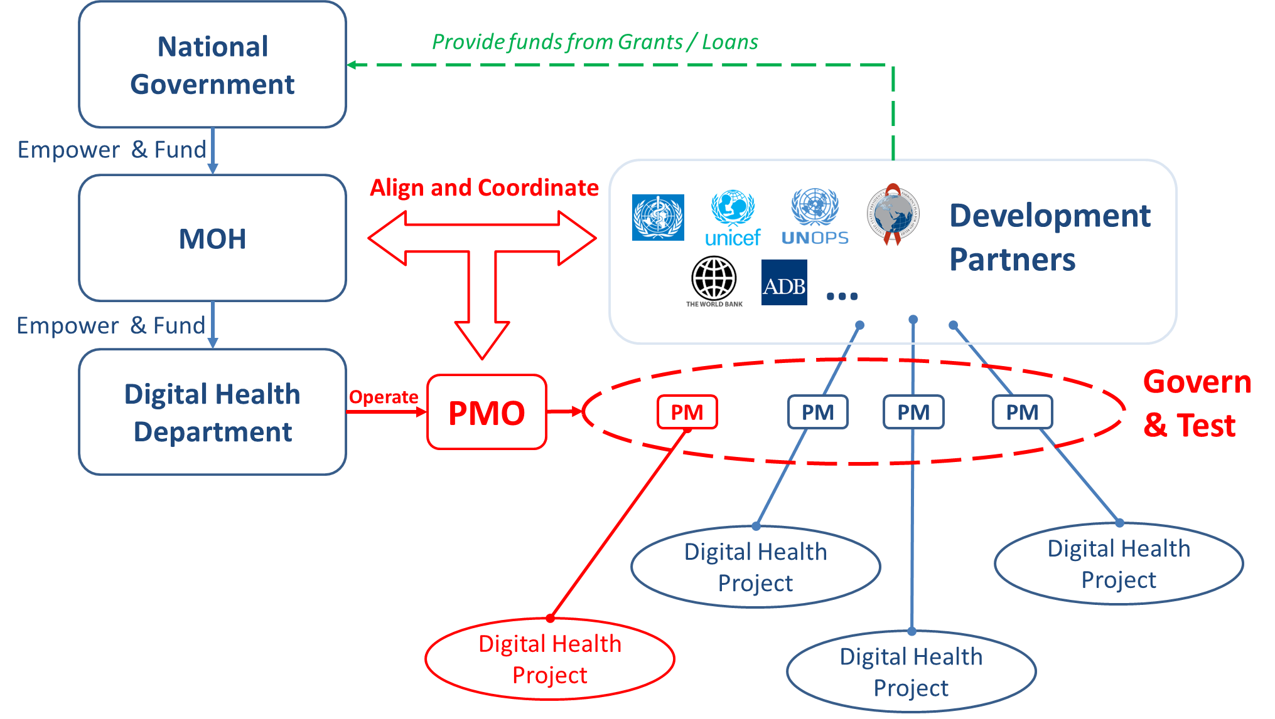
CONCEPTUAL PMO STRUCTURE

Slide 102
CONCEPTUAL PMO STRUCTURE
An agency or department, under the auspices of the MOH, will operate a programme management office (PMO).
The PMO will coordinate activities of the project managers (PM) across all stakeholder projects (MOH, private sector, development partner).
The PMO will govern conformance testing of digital health deliverables.
The MOH will manage access permissions to the HIE.

Slide 103
ADOPTION PRINCIPLES
To generate interest and set up for significant value capture, choose a set of initial guideline-based care pathways that matter (e.g. high ranked in the IHME top-10 list of burden of disease).
Create a network effect:
Implement the HIE, first.
Implement a rapid (real time) CR onboarding process.
Set up conformance testing.
Connect waves of conformant POS solutions at a time.
Try to bring entire referral networks onboard at the same time.
Try to import siloed data holdings to accelerate care continuity.

Slide 104
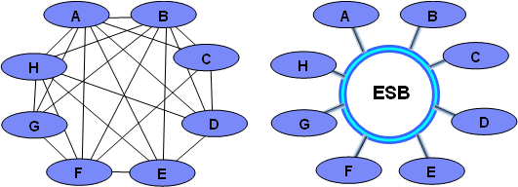
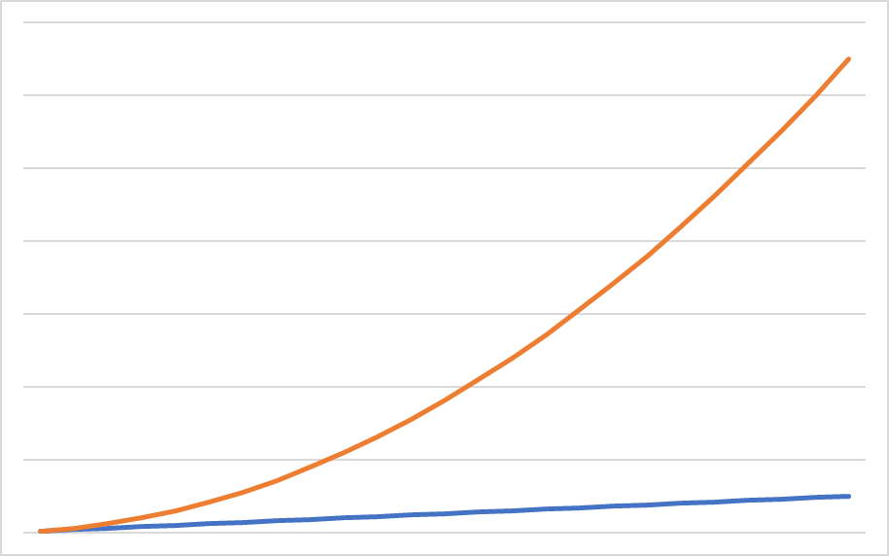
Implementing the HIE first addresses the permutation and combinations problem associated with of point-to-point data sharing.
Every new point of care that connects to the network can immediately share health data with every other point that is already connected. This builds geometrically increasing value and momentum as the implementation progresses.
HIE
Number of Data Sharing
Connections (value)
Number of Points of Care
on the national HIE (cost)

Slide 105
BUY VS BUILD HIE INFRASTRUCTURE OPTIONS
HIE Infrastructure-as-a-Service (IaaS)
HIE “Private” Cloud
Stick-built HIE
Hybrid cloud Infrastructure-as-a-Service (IaaS) offering procured as a long-term contract from a credible cloud service provider. Multiple hosted services (including legacy solutions) packaged and operated as a single service for a monthly fee.
An HIE solution stack is built by a credible service provider. License fees and annual maintenance fees may apply. Entire HIE stack is hosted on a cloud infrastructure that may be operated and maintained in cooperation with an eGovernment shared service.
The MOH stick-builds an HIE solution from a customized software stack they construct and maintain themselves. The HIE component elements are hosted on infrastructure operated and maintained by the MOH.

Slide 106
Buy vs Build HIE infrastructure options
HIE Infrastructure-as-a-Service (IaaS)
HIE “Private” Cloud
Stick-built HIE
Hybrid cloud Infrastructure-as-a-Service (IaaS) offering procured as a long-term contract from a credible cloud service provider. Multiple hosted services (including legacy solutions) packaged and operated as a single service for a monthly fee.
An HIE solution stack is built by a credible service provider. License fees and annual maintenance fees may apply. Entire HIE stack is hosted on a cloud infrastructure that may be operated and maintained in cooperation with an eGovernment shared service.
The MOH stick-builds an HIE solution from a customized software stack they construct and maintain themselves. The HIE component elements are hosted on infrastructure operated and maintained by the MOH.

Slide 107




HEALTH ID CREDENTIAL OPTIONS
4-digit PIN
ID#:
Name:
DOB:
Sex:
Mother’s Name:
123456789
Able Baker Chow
1990-06-15
M
Isabel Mwani Chow
ID#:
Name:
DOB:
Sex:
Mother’s Name:
123456789
Able Baker Chow
1990-06-15
M
Isabel Mwani Chow
A simple pre-barcoded card with key demographics either typed or handwritten in can be effective. If put in a plastic sleeve, these can be an inexpensive and durable option. If a PIN is associated with the card’s ID#, these can provide two-factor authentication.
Printed plastic cards that include a person’s picture add forgery protection and support two factor authentication. Photo capture and card printing requires special equipment.
Biometric options such as iris scans or fingerprints may be leveraged for adult persons. Collecting the scans and deploying readers at scale can have non-trivial cost implications.

Slide 108
CRITICAL SLICE IMPLEMENTATIONS
Level-3
Level-2
Level-1
As a deployment option, deploying all of the purple sites, first, will yield immediate health benefit because the whole of the referral network is implemented. Strategically grouping deployment sites can yield health benefits earlier in the implementation.

Slide 109
KEY TAKEAWAY POINTS
As a management principle, we will want to ensure coordination across all digital health projects and conformance to the national norms and standards. This will be operationalized by our PMO.
As an adoption principle, we will want to harness the power of the network effect by establishing the HIE first and by leveraging critical slice implementations.
Key implementation choices related to infrastructure hosting and wallet ID (as examples) will have significant impacts on risk, time and cost.

Slide 110

Questions and Answers?

Slide 111

COFFEE BREAK!
Notes:
Use this slide as a “break slide”

Slide 112

How much progress have we made in moving forward with our digital health agenda?

Slide 113
IMPLEMENTATION PROGRESS
Obtain information about the present state of digital health rollout.
Summarize key points. Reference existing blueprint artefacts, if they exist. Reference existing budgets, if they exist.
If they are present in the workshop, invite the relevant implementing partners to provide comments on the status update.
NOTE example from Botswana…

Slide 114
PRESENT STATUS
Executing Digital Health Strategy (2020-2024)
Active TAP project underway (HIV-focused)
FHIR-based HIE based on IPS under construction; tech assessment complete on first use cases (UC1, UC2)
UB/UCSF Health EA initiative underway; Jul-8 meeting planned
WHO-supported DHIS2 initiative underway (expanding upon Tracker-supported COVID workflows)
Planned replacement of PIMS point-of-service (POS) solution with OpenMRS EMR

Slide 115
Recent draft of Health Enterprise Architecture

Slide 116
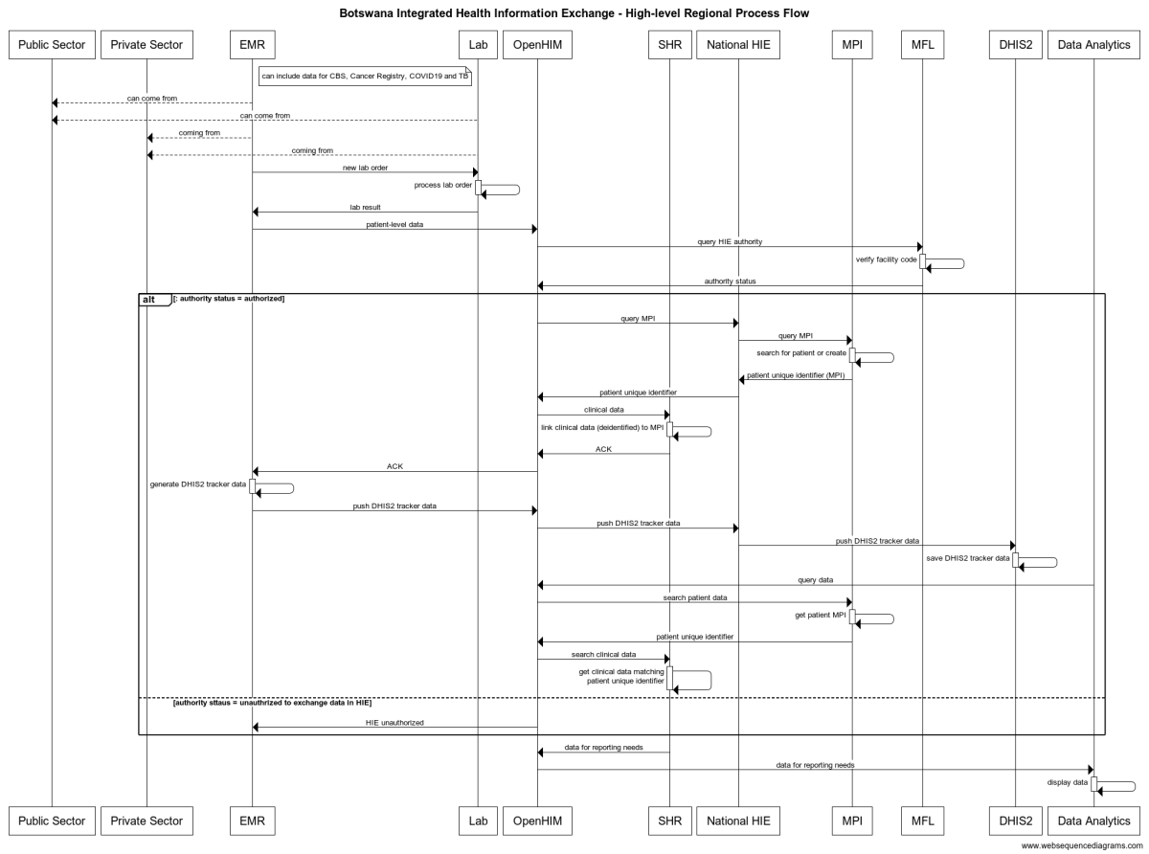
OpenHIM-orchestrated regional process flows for Lab Orders / Reports and DHIS2-based analytics.
In progress.

Slide 117
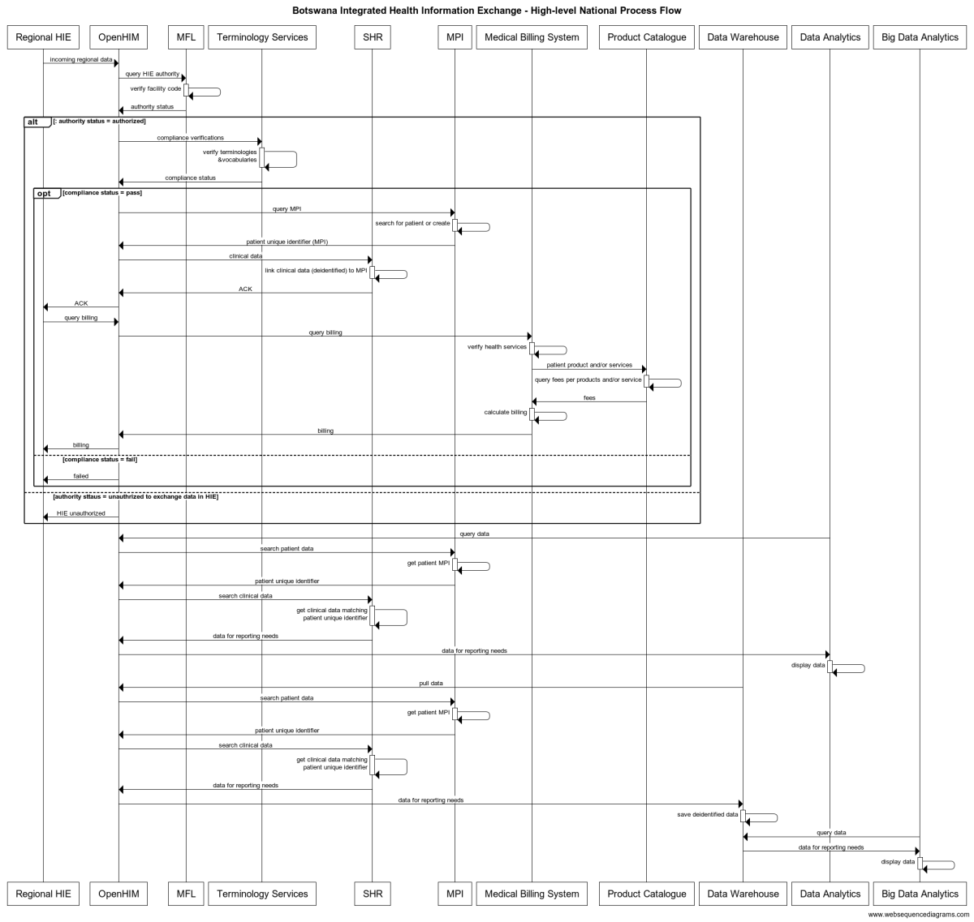
OpenHIM-orchestrated national process flows for claims adjudication and national-level analytics using DHIS2.
In progress.

Slide 118

<insert this slide where needed as a “Q&A” slide after major presentation sections>
Questions and Answers?

Slide 119

COFFEE BREAK!
<insert this slide where needed as a “break” slide for coffee/tea or lunch breaks>
Notes:
Use this slide as a “break slide”

